Slide 1
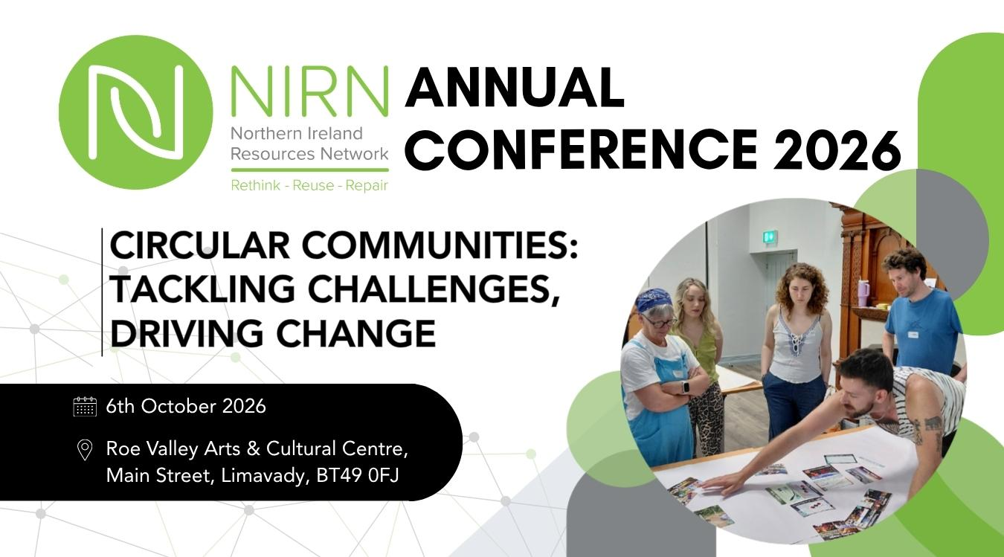


Slide 2
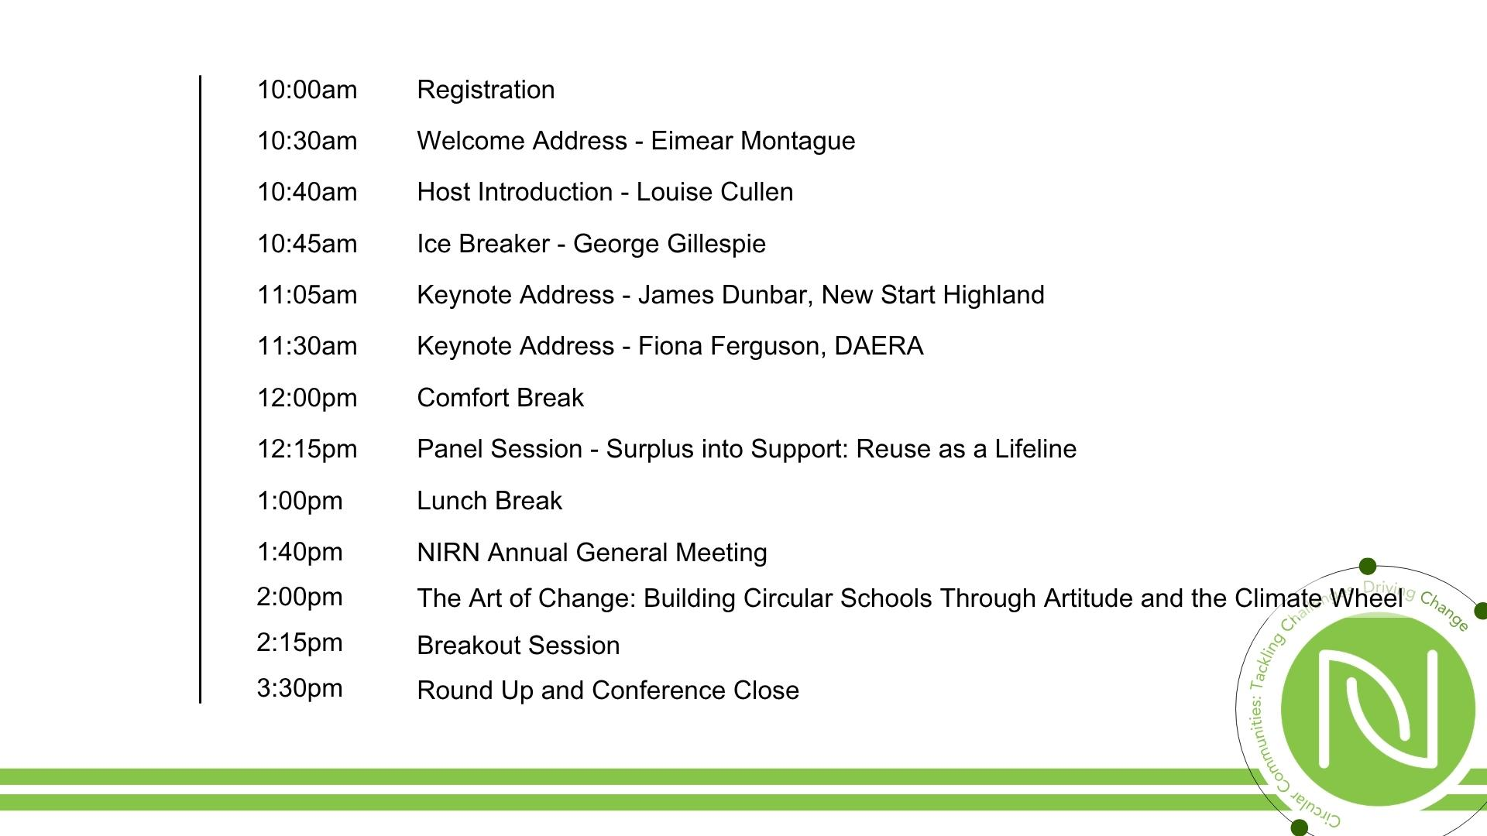
Today’s Agenda

Slide 3
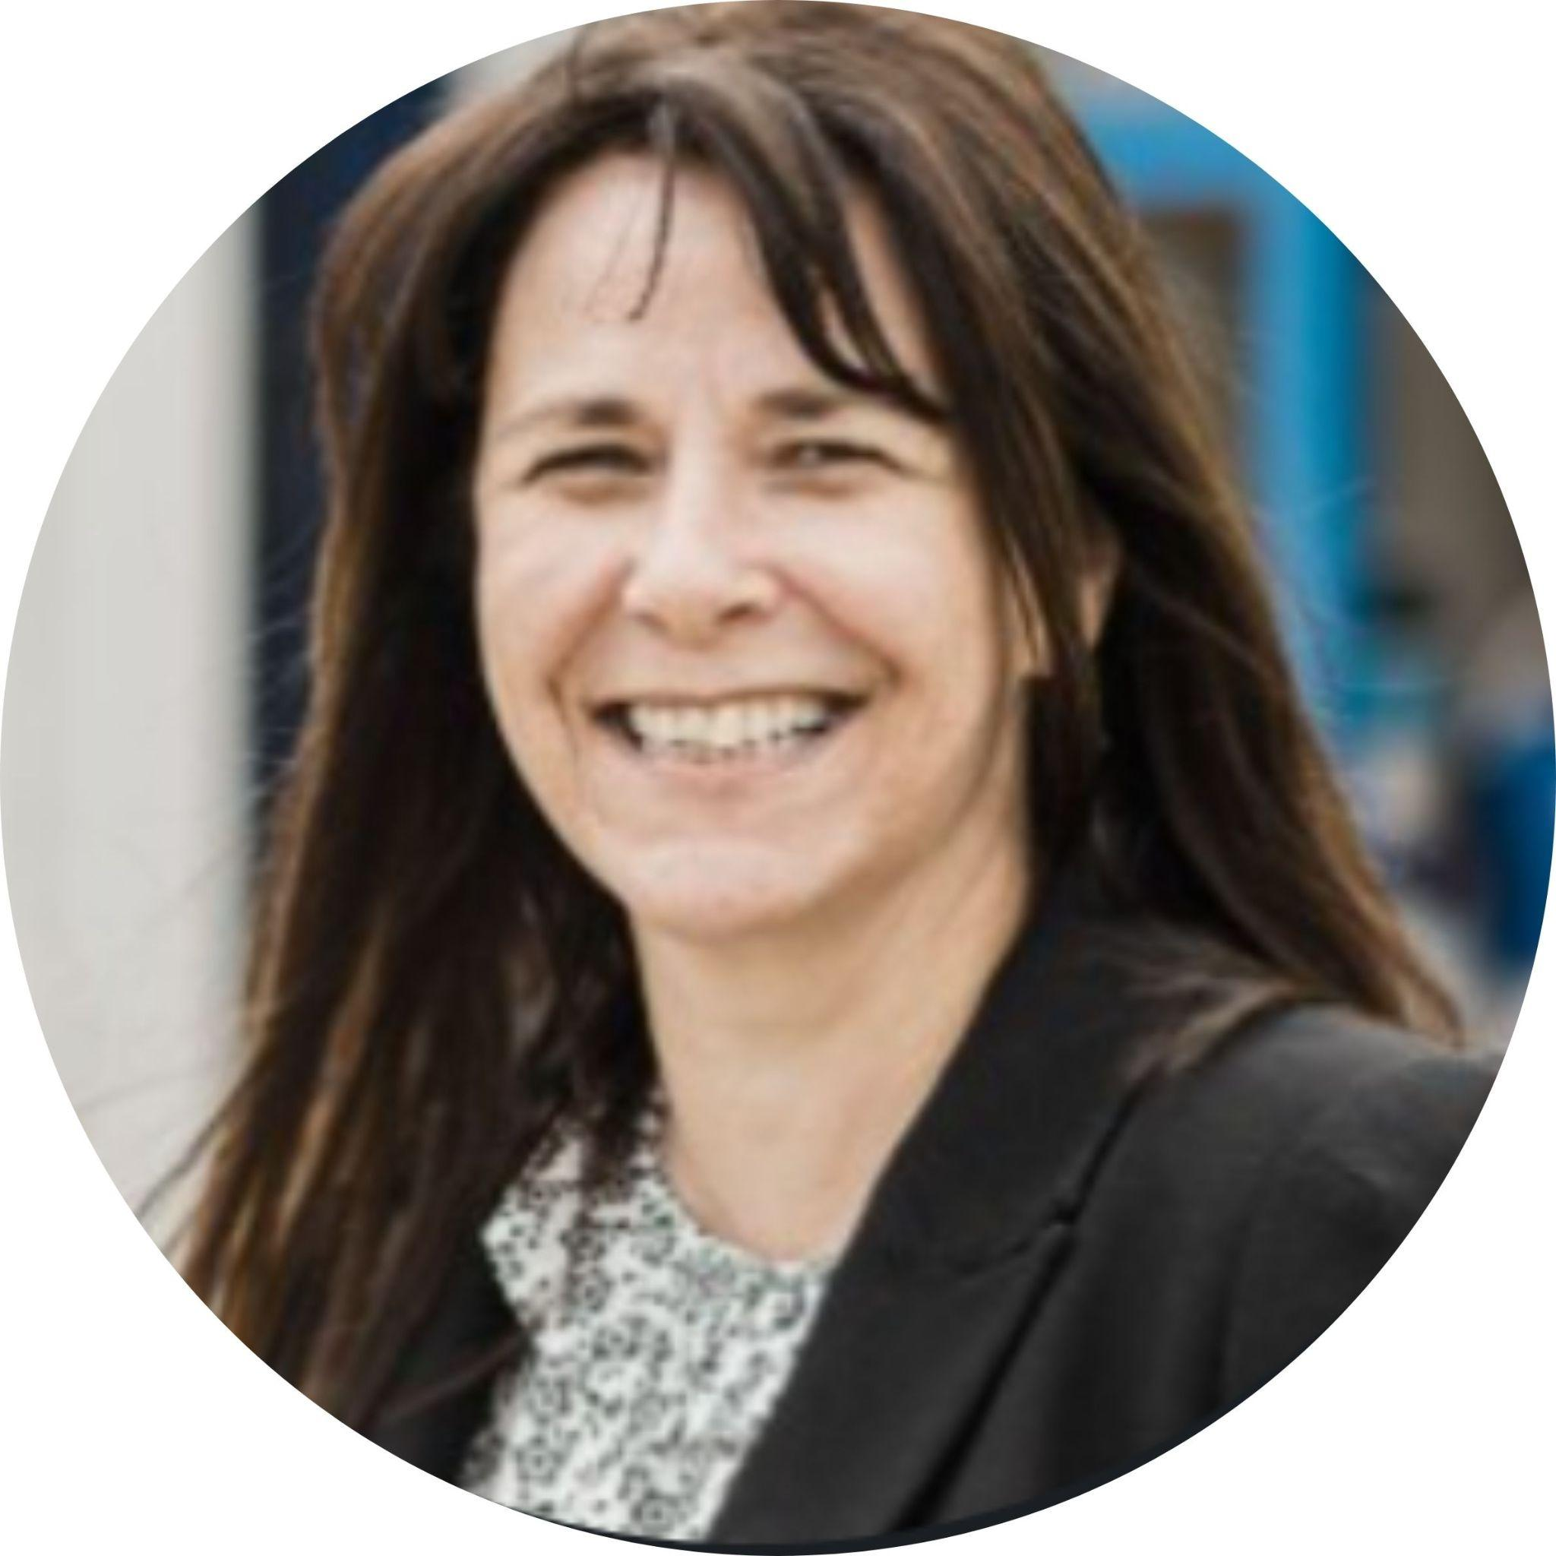
Welcome Address
Eimear Montague
Executive Director of NIRN

Slide 4
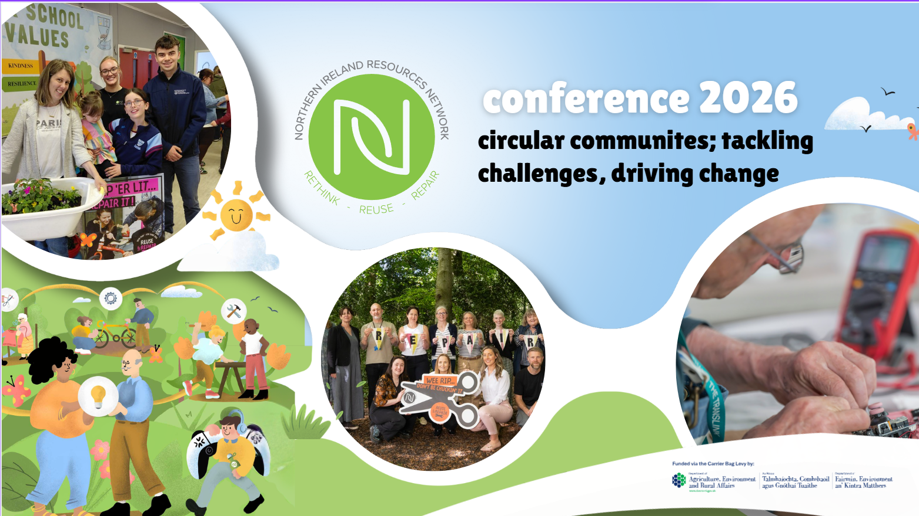

NIRN Conference 2026
Circular Communities: Tackling Challenges, Driving Change

Slide 5





reuse and repair week

Slide 6
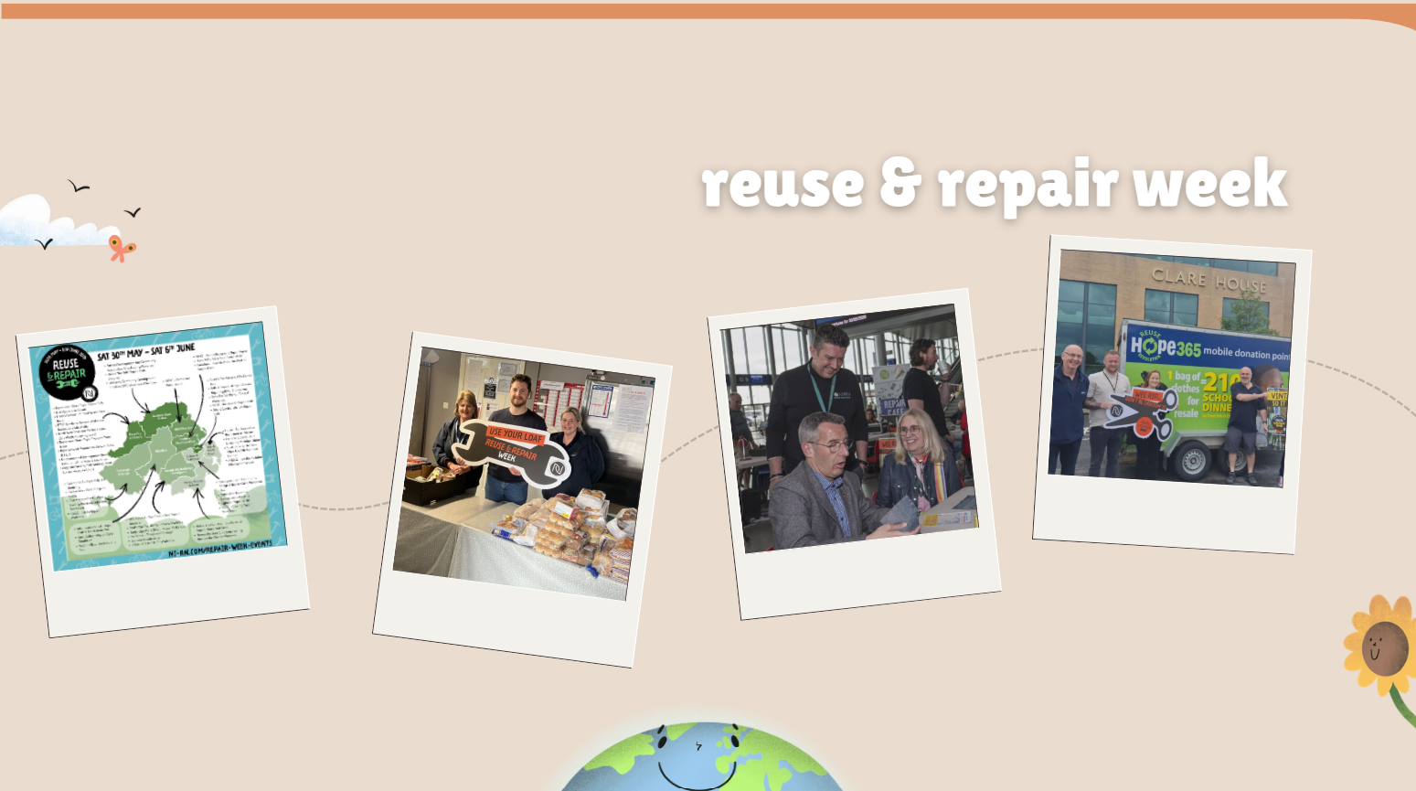
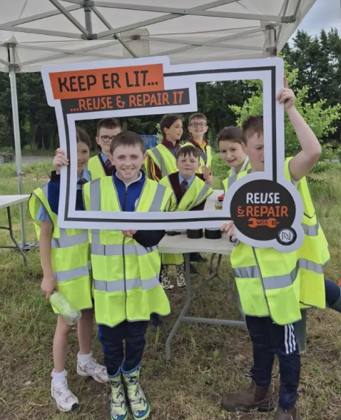
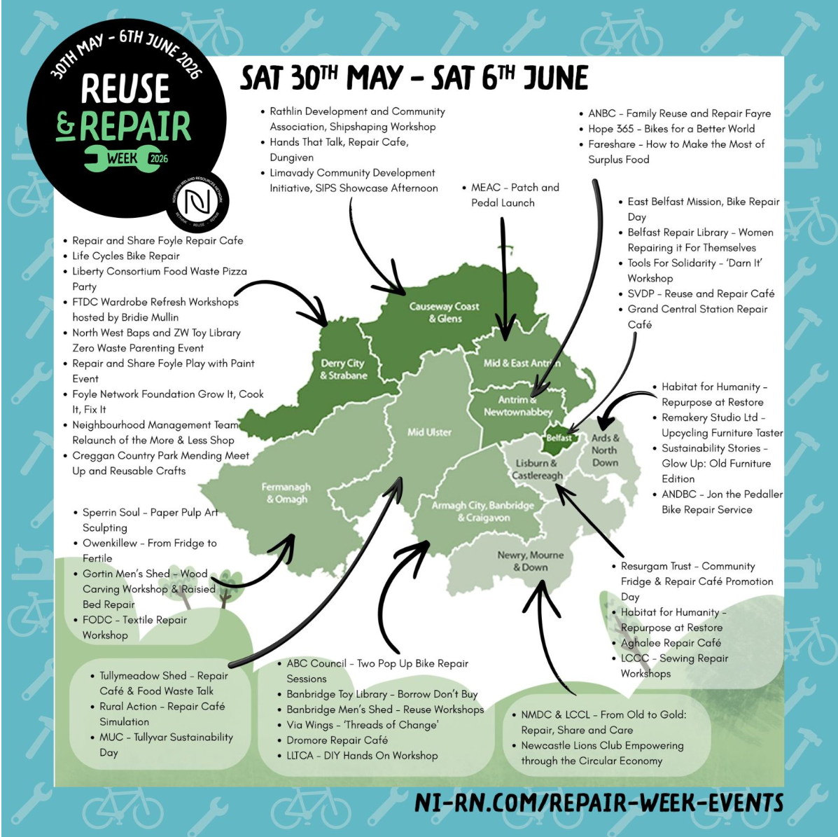
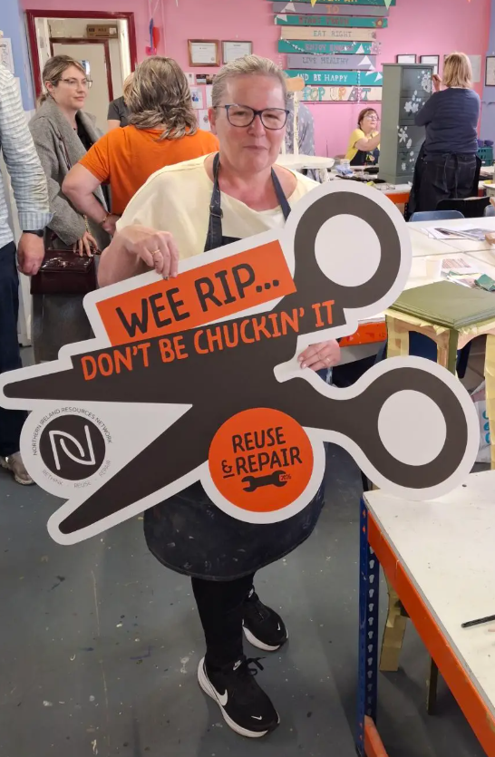
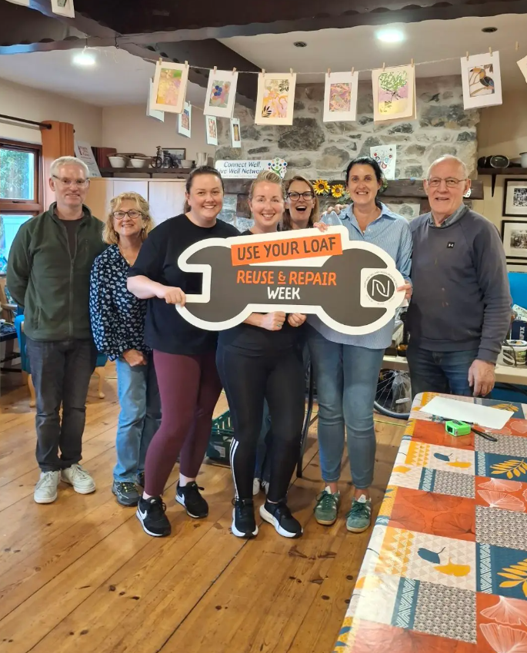
reuse & repair week 2026

Slide 7
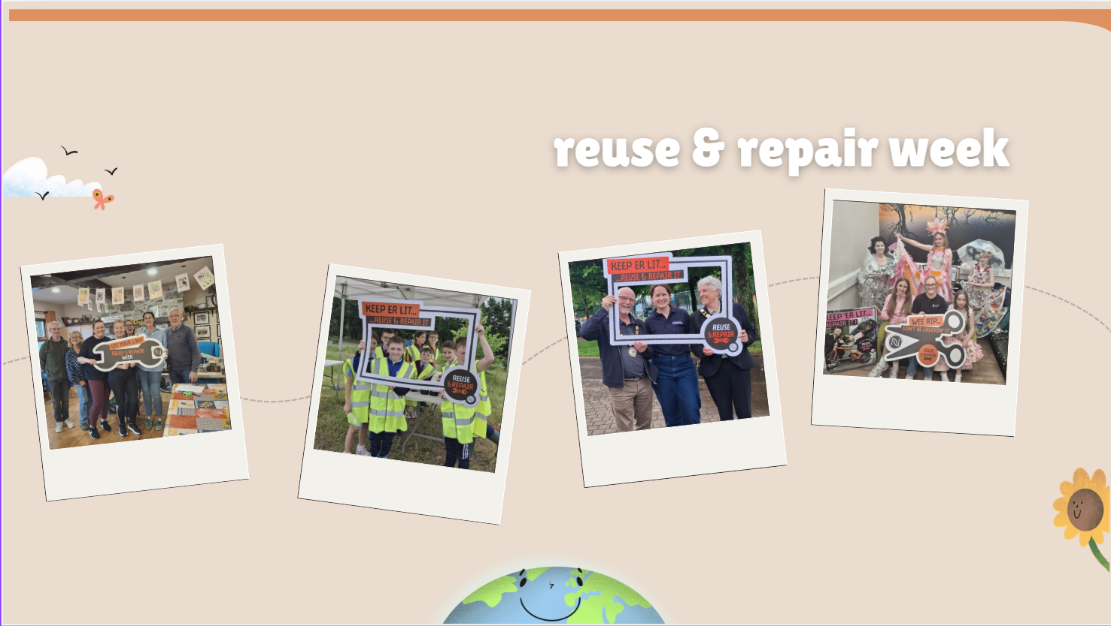
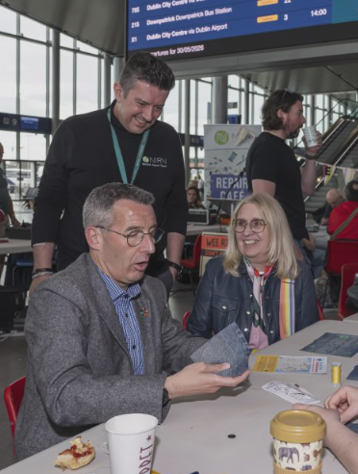
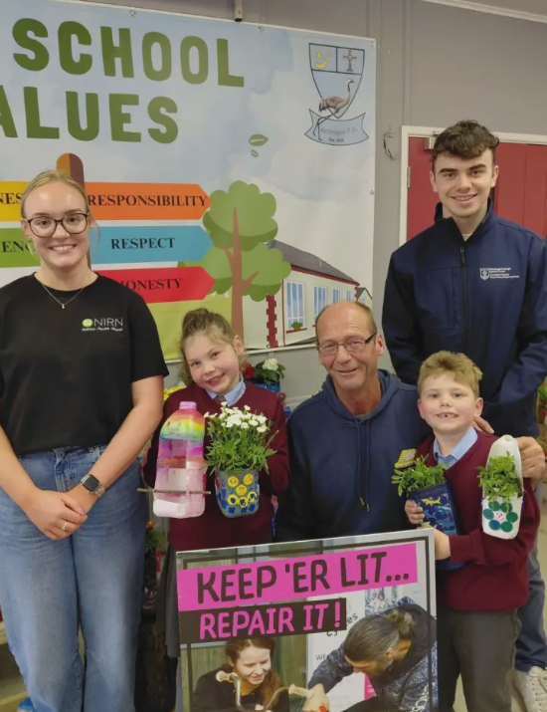
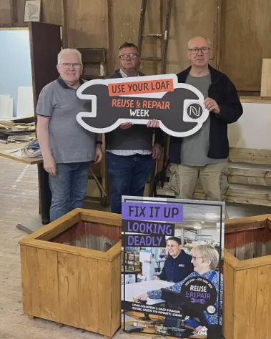
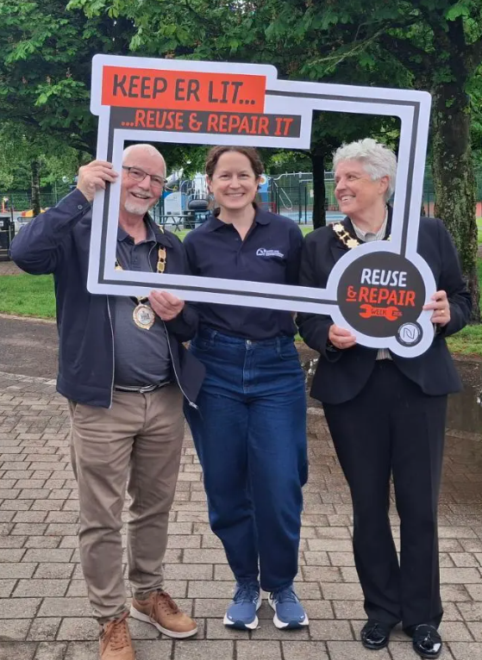
reuse and repair week 2026

Slide 8
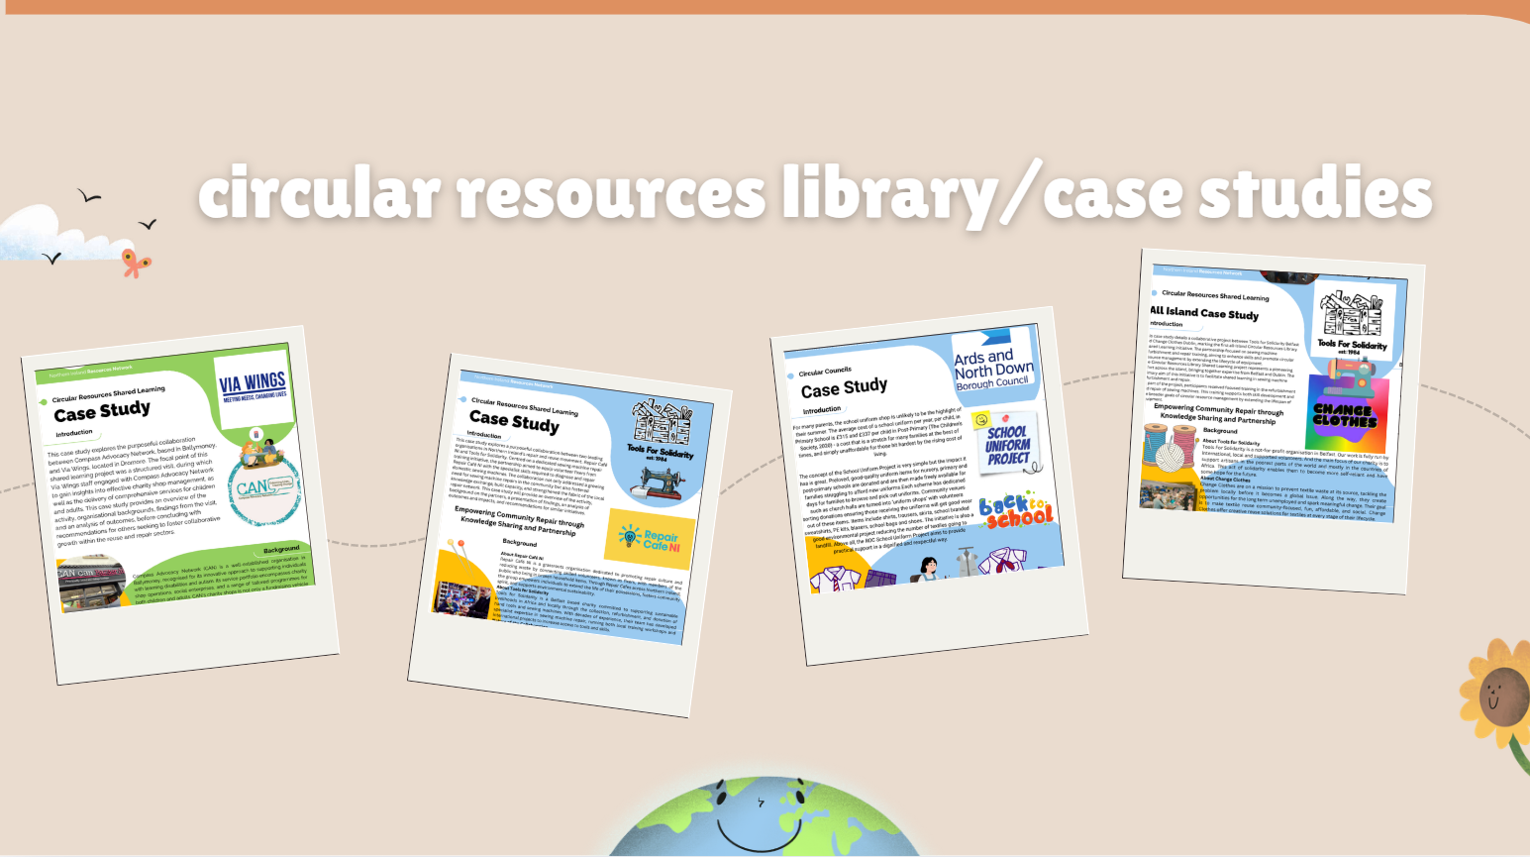
reuse and repair week 2026

Slide 9
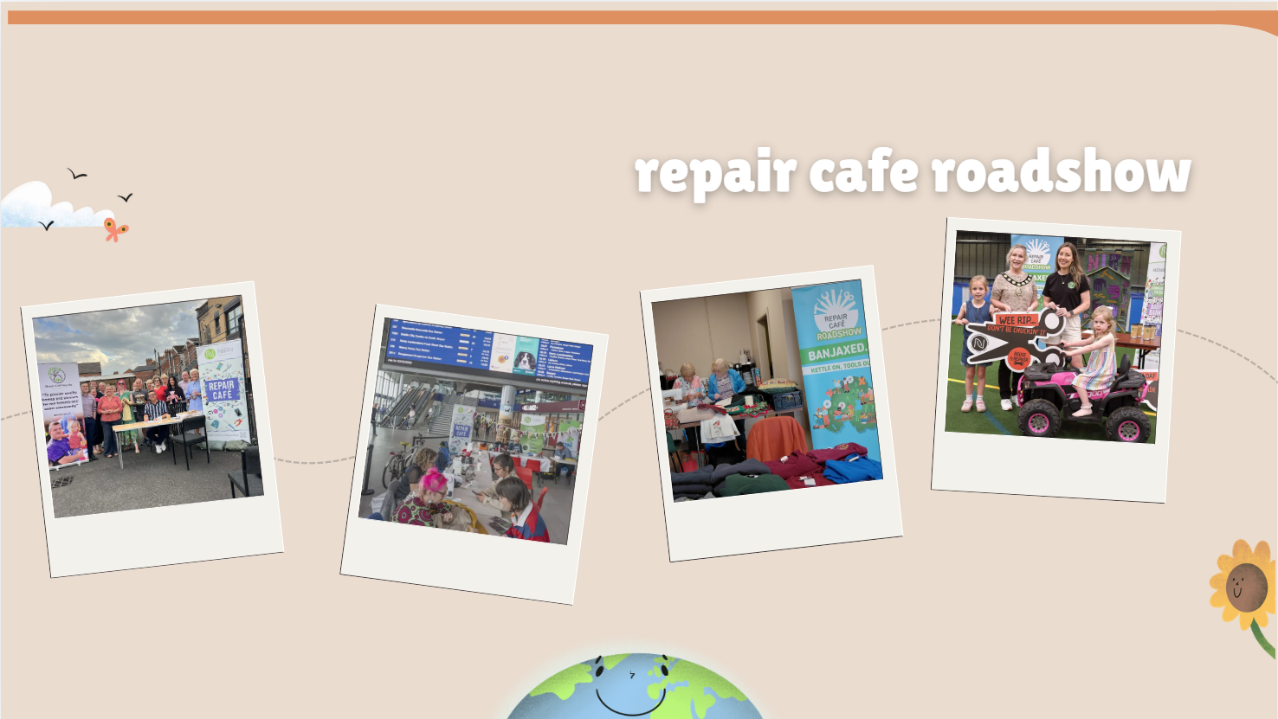
repair cafe roadshow

Slide 10
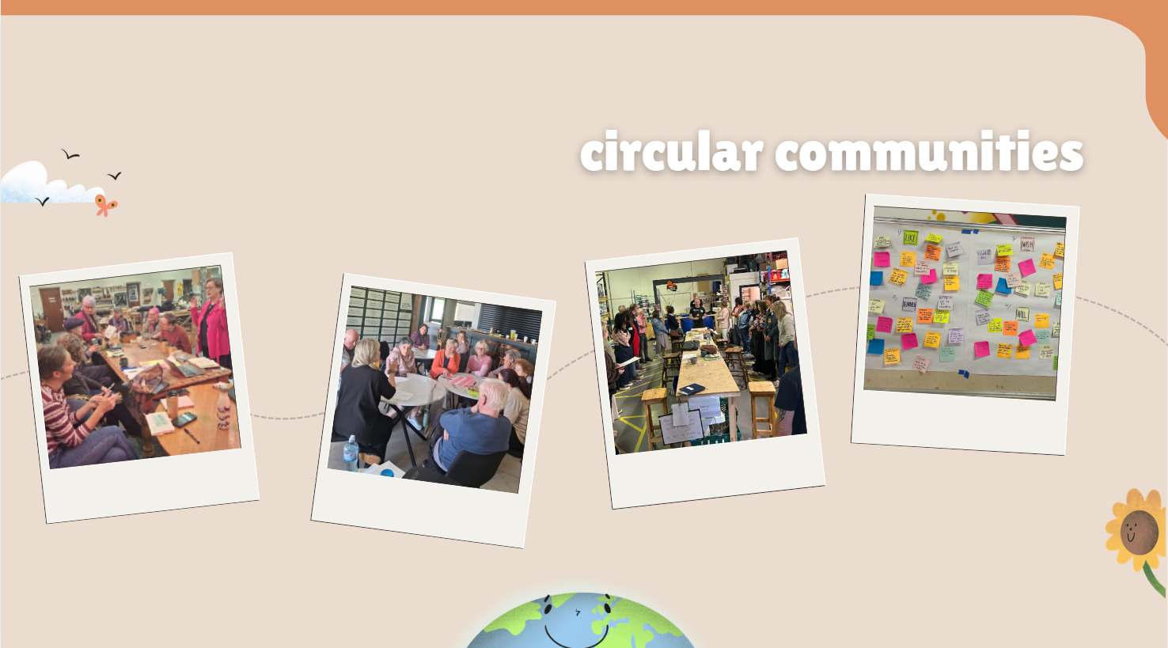
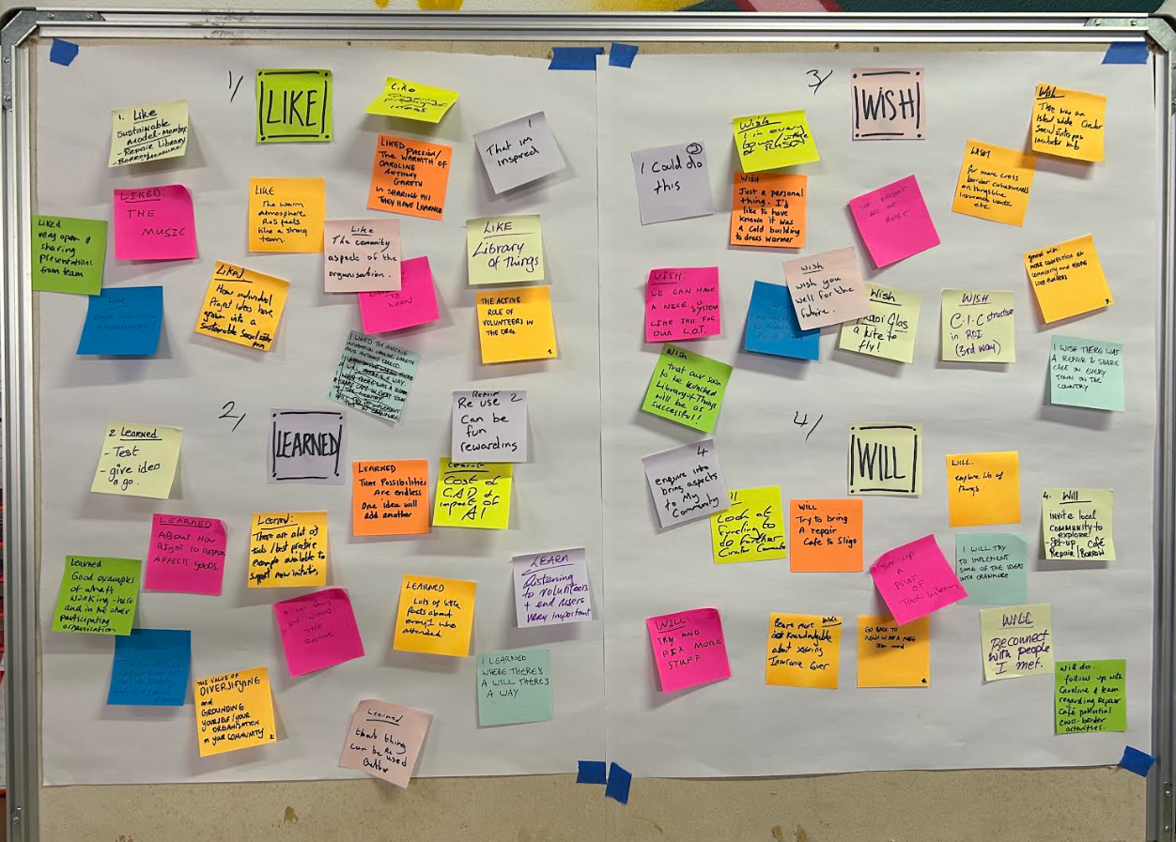
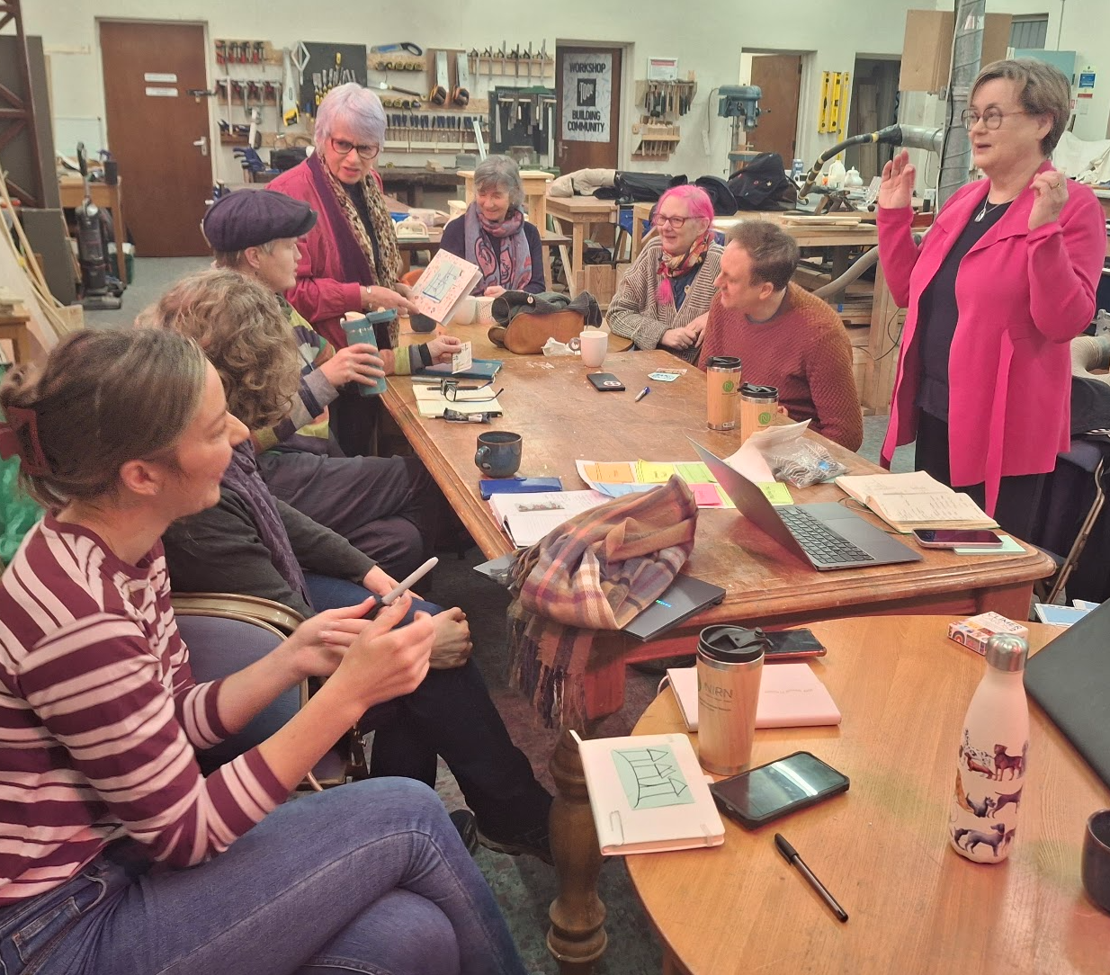
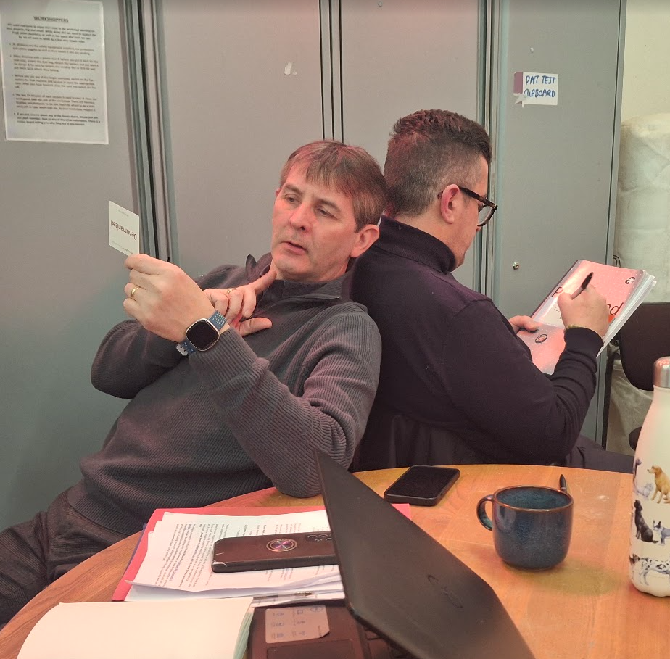
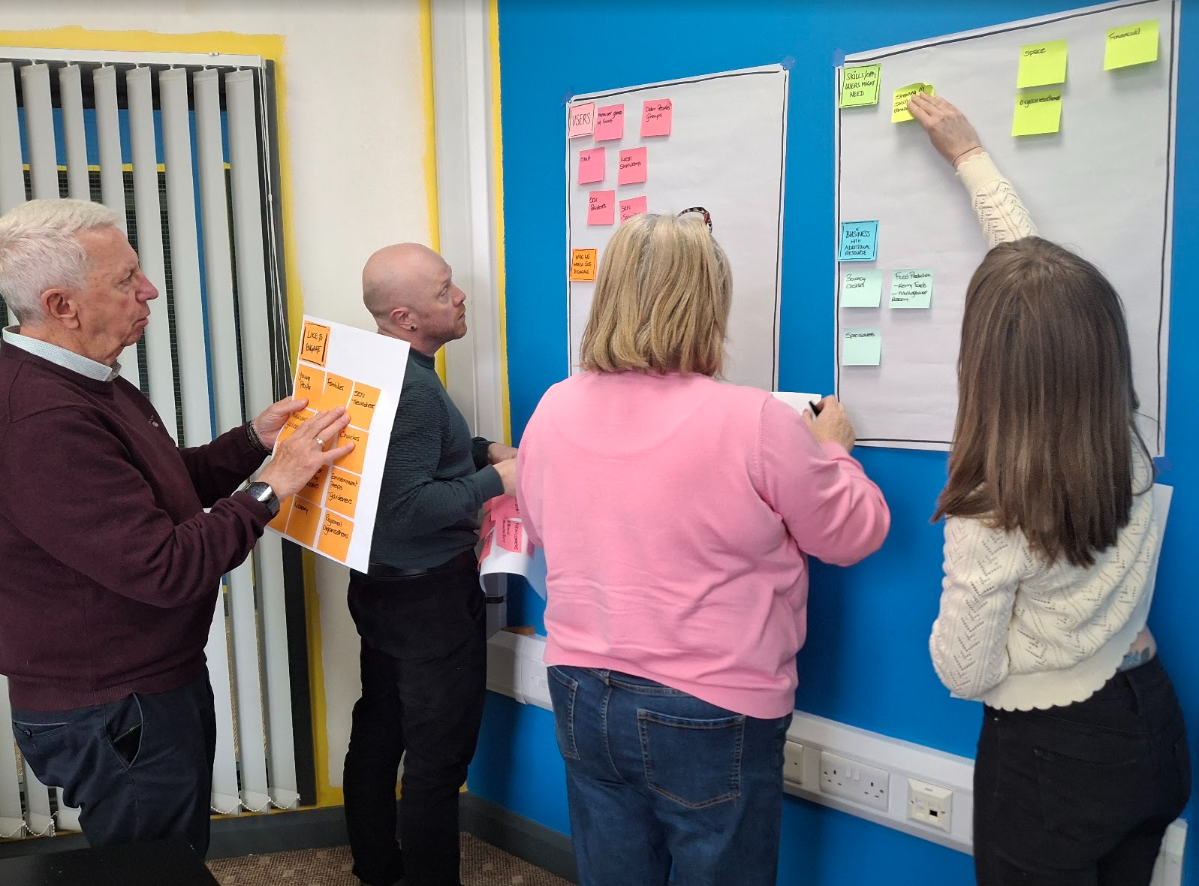
circular communities

Slide 11
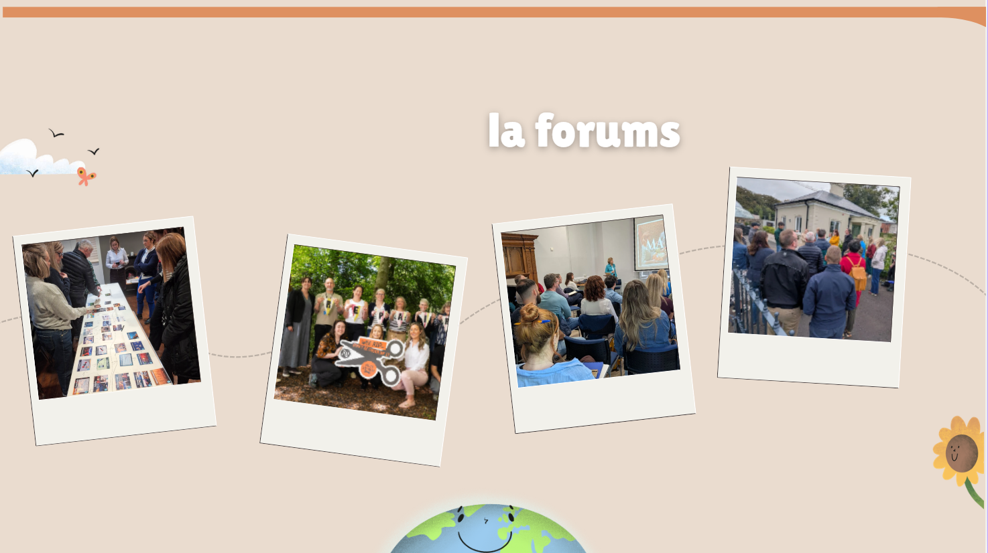
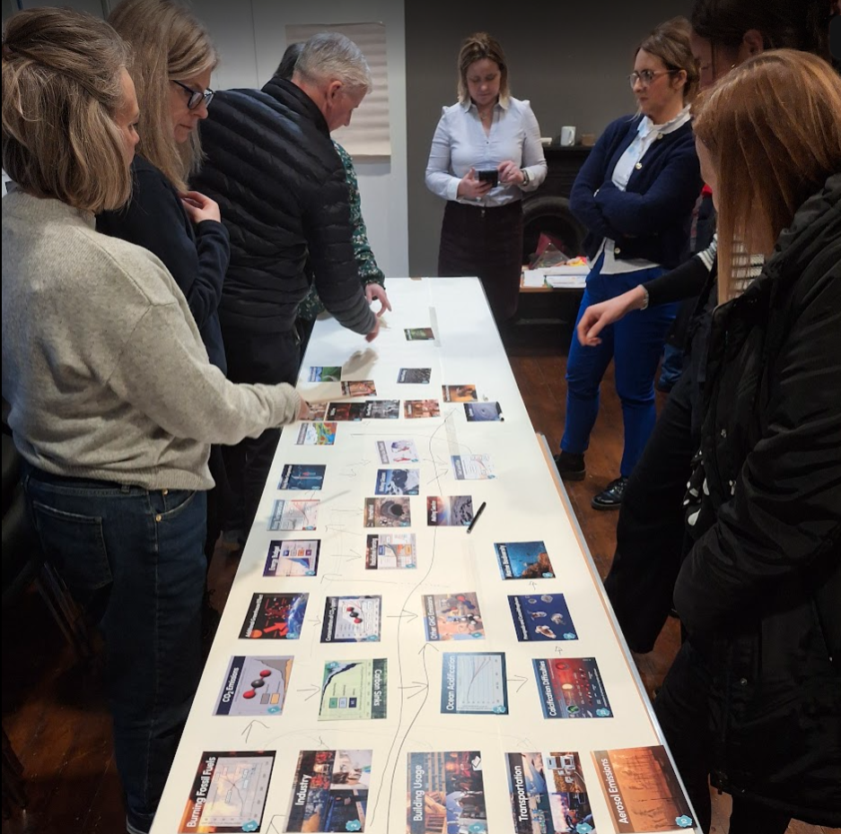
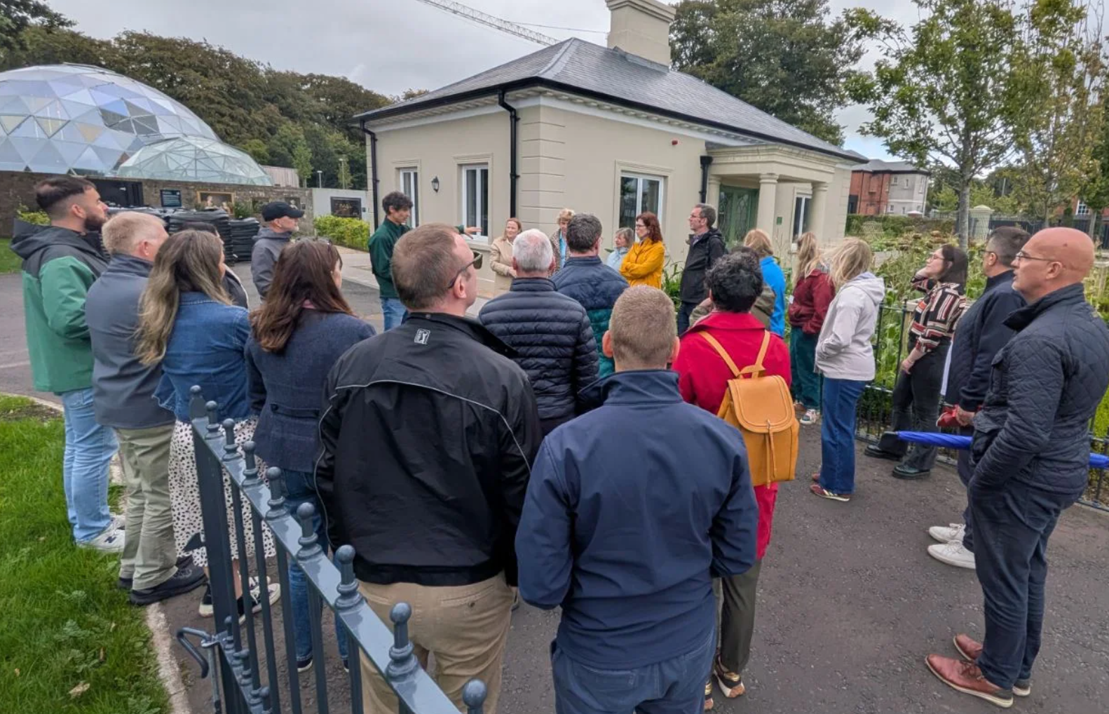
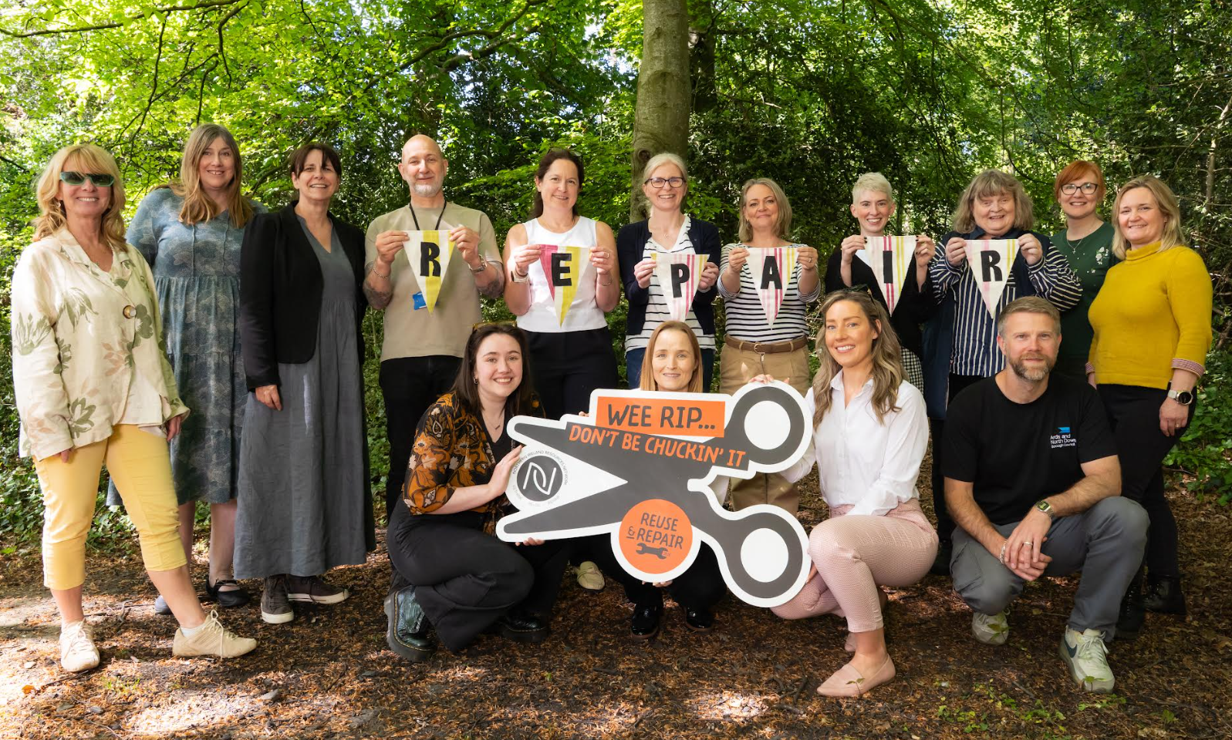
la forums

Slide 12

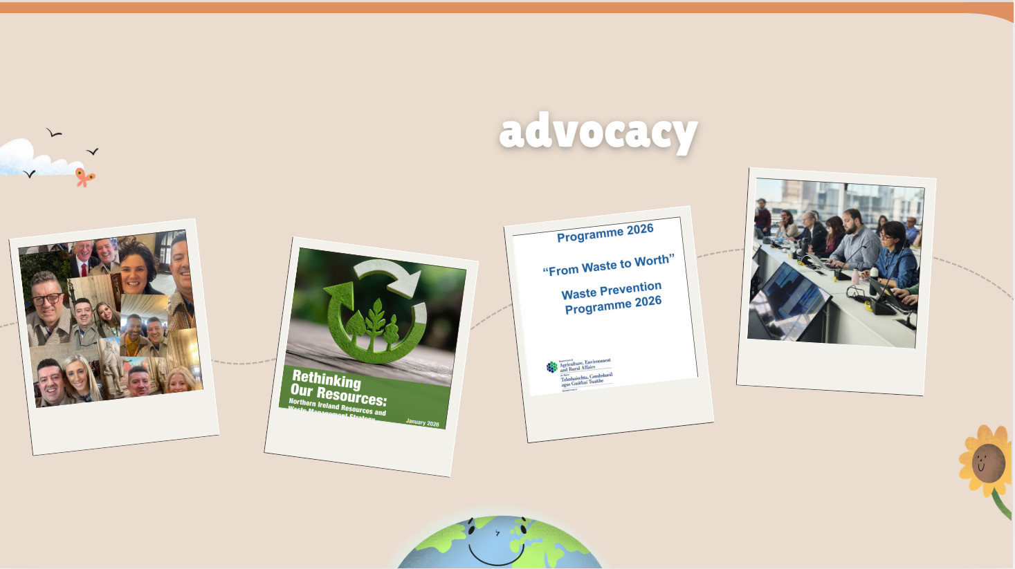

Slide 13

NIRN Members

Slide 14
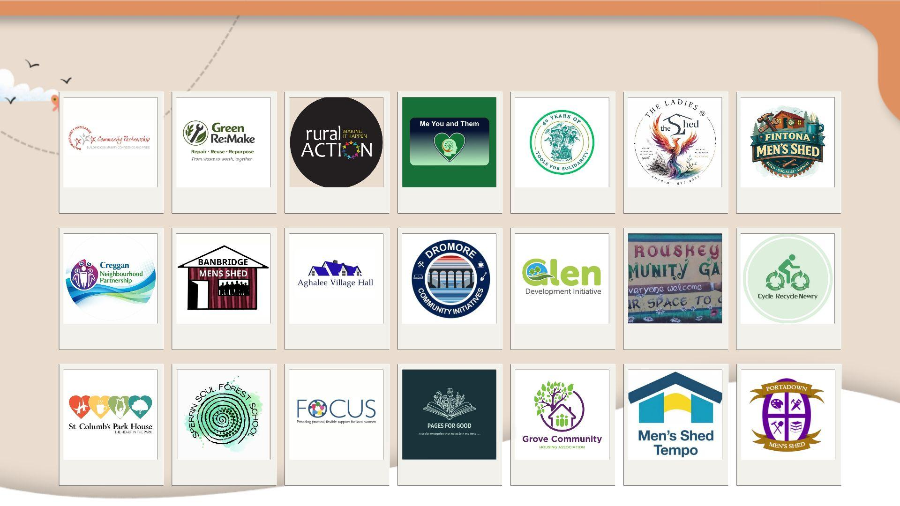
New NIRN Members

Slide 15

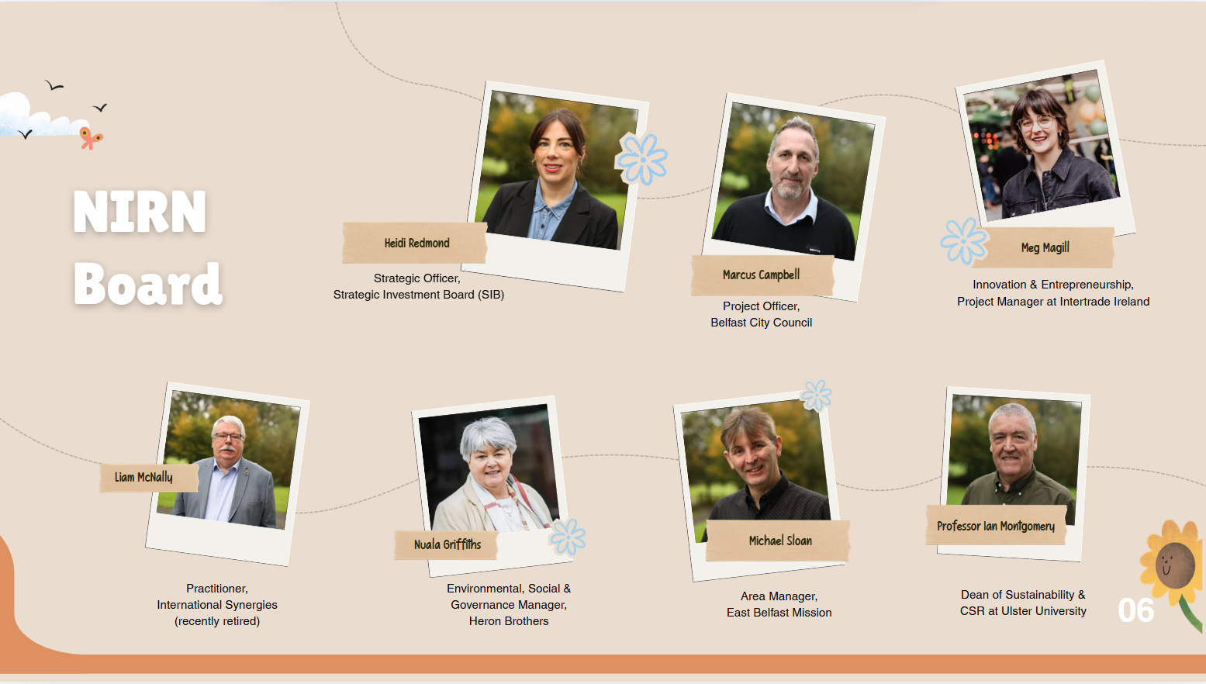

title
subtitle
Insert body text here
Insert body text here
Insert body text here

Slide 16
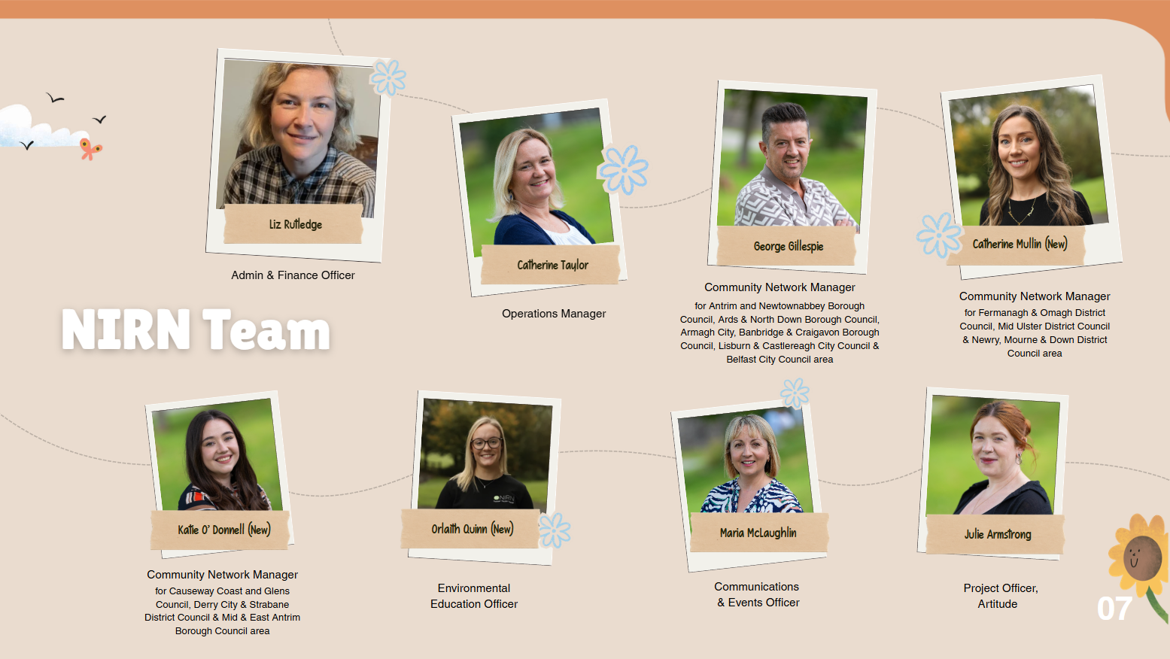
title
subtitle
Insert body text here
Insert body text here
Insert body text here

Slide 17

thank you

Slide 18

Conference Host
Louise Cullen
BBC NI Agri/Environment Correspondent

Slide 19
Ice Breaker

Slide 20
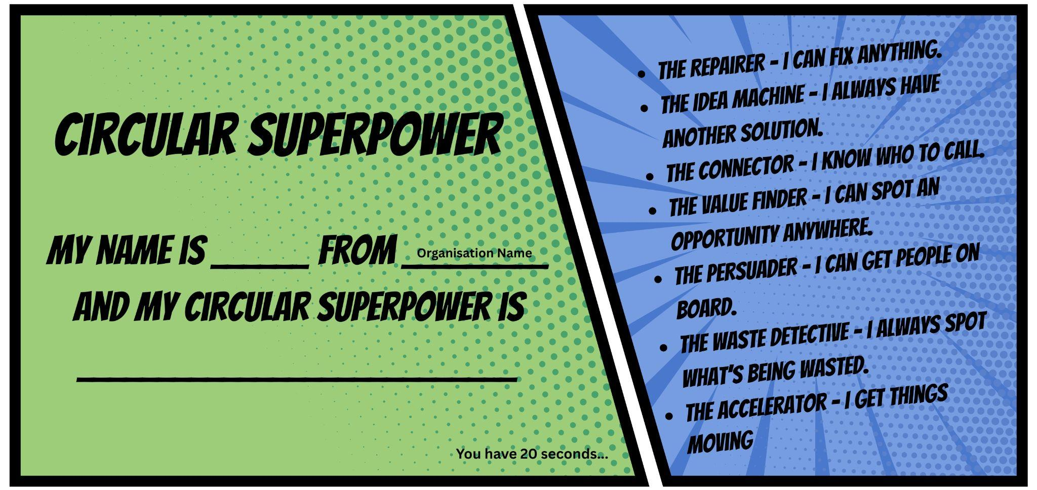

Part 1: The Creative Reuse Quest

Slide 21
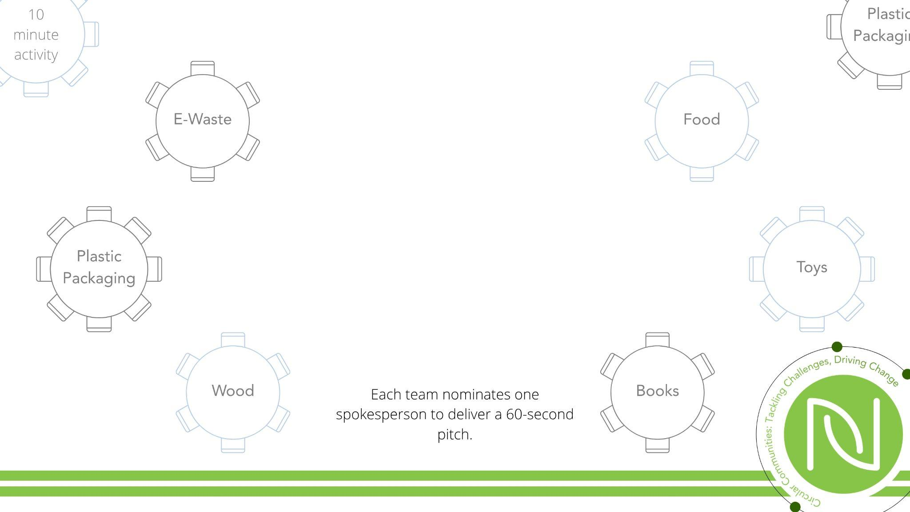
Part 2: The Challenge
What value is being lost?
What’s one circular solution?
Who would benefit?
What’s the biggest barrier to making it happen?

Slide 22

Part 3: Wrap It Up

Slide 23
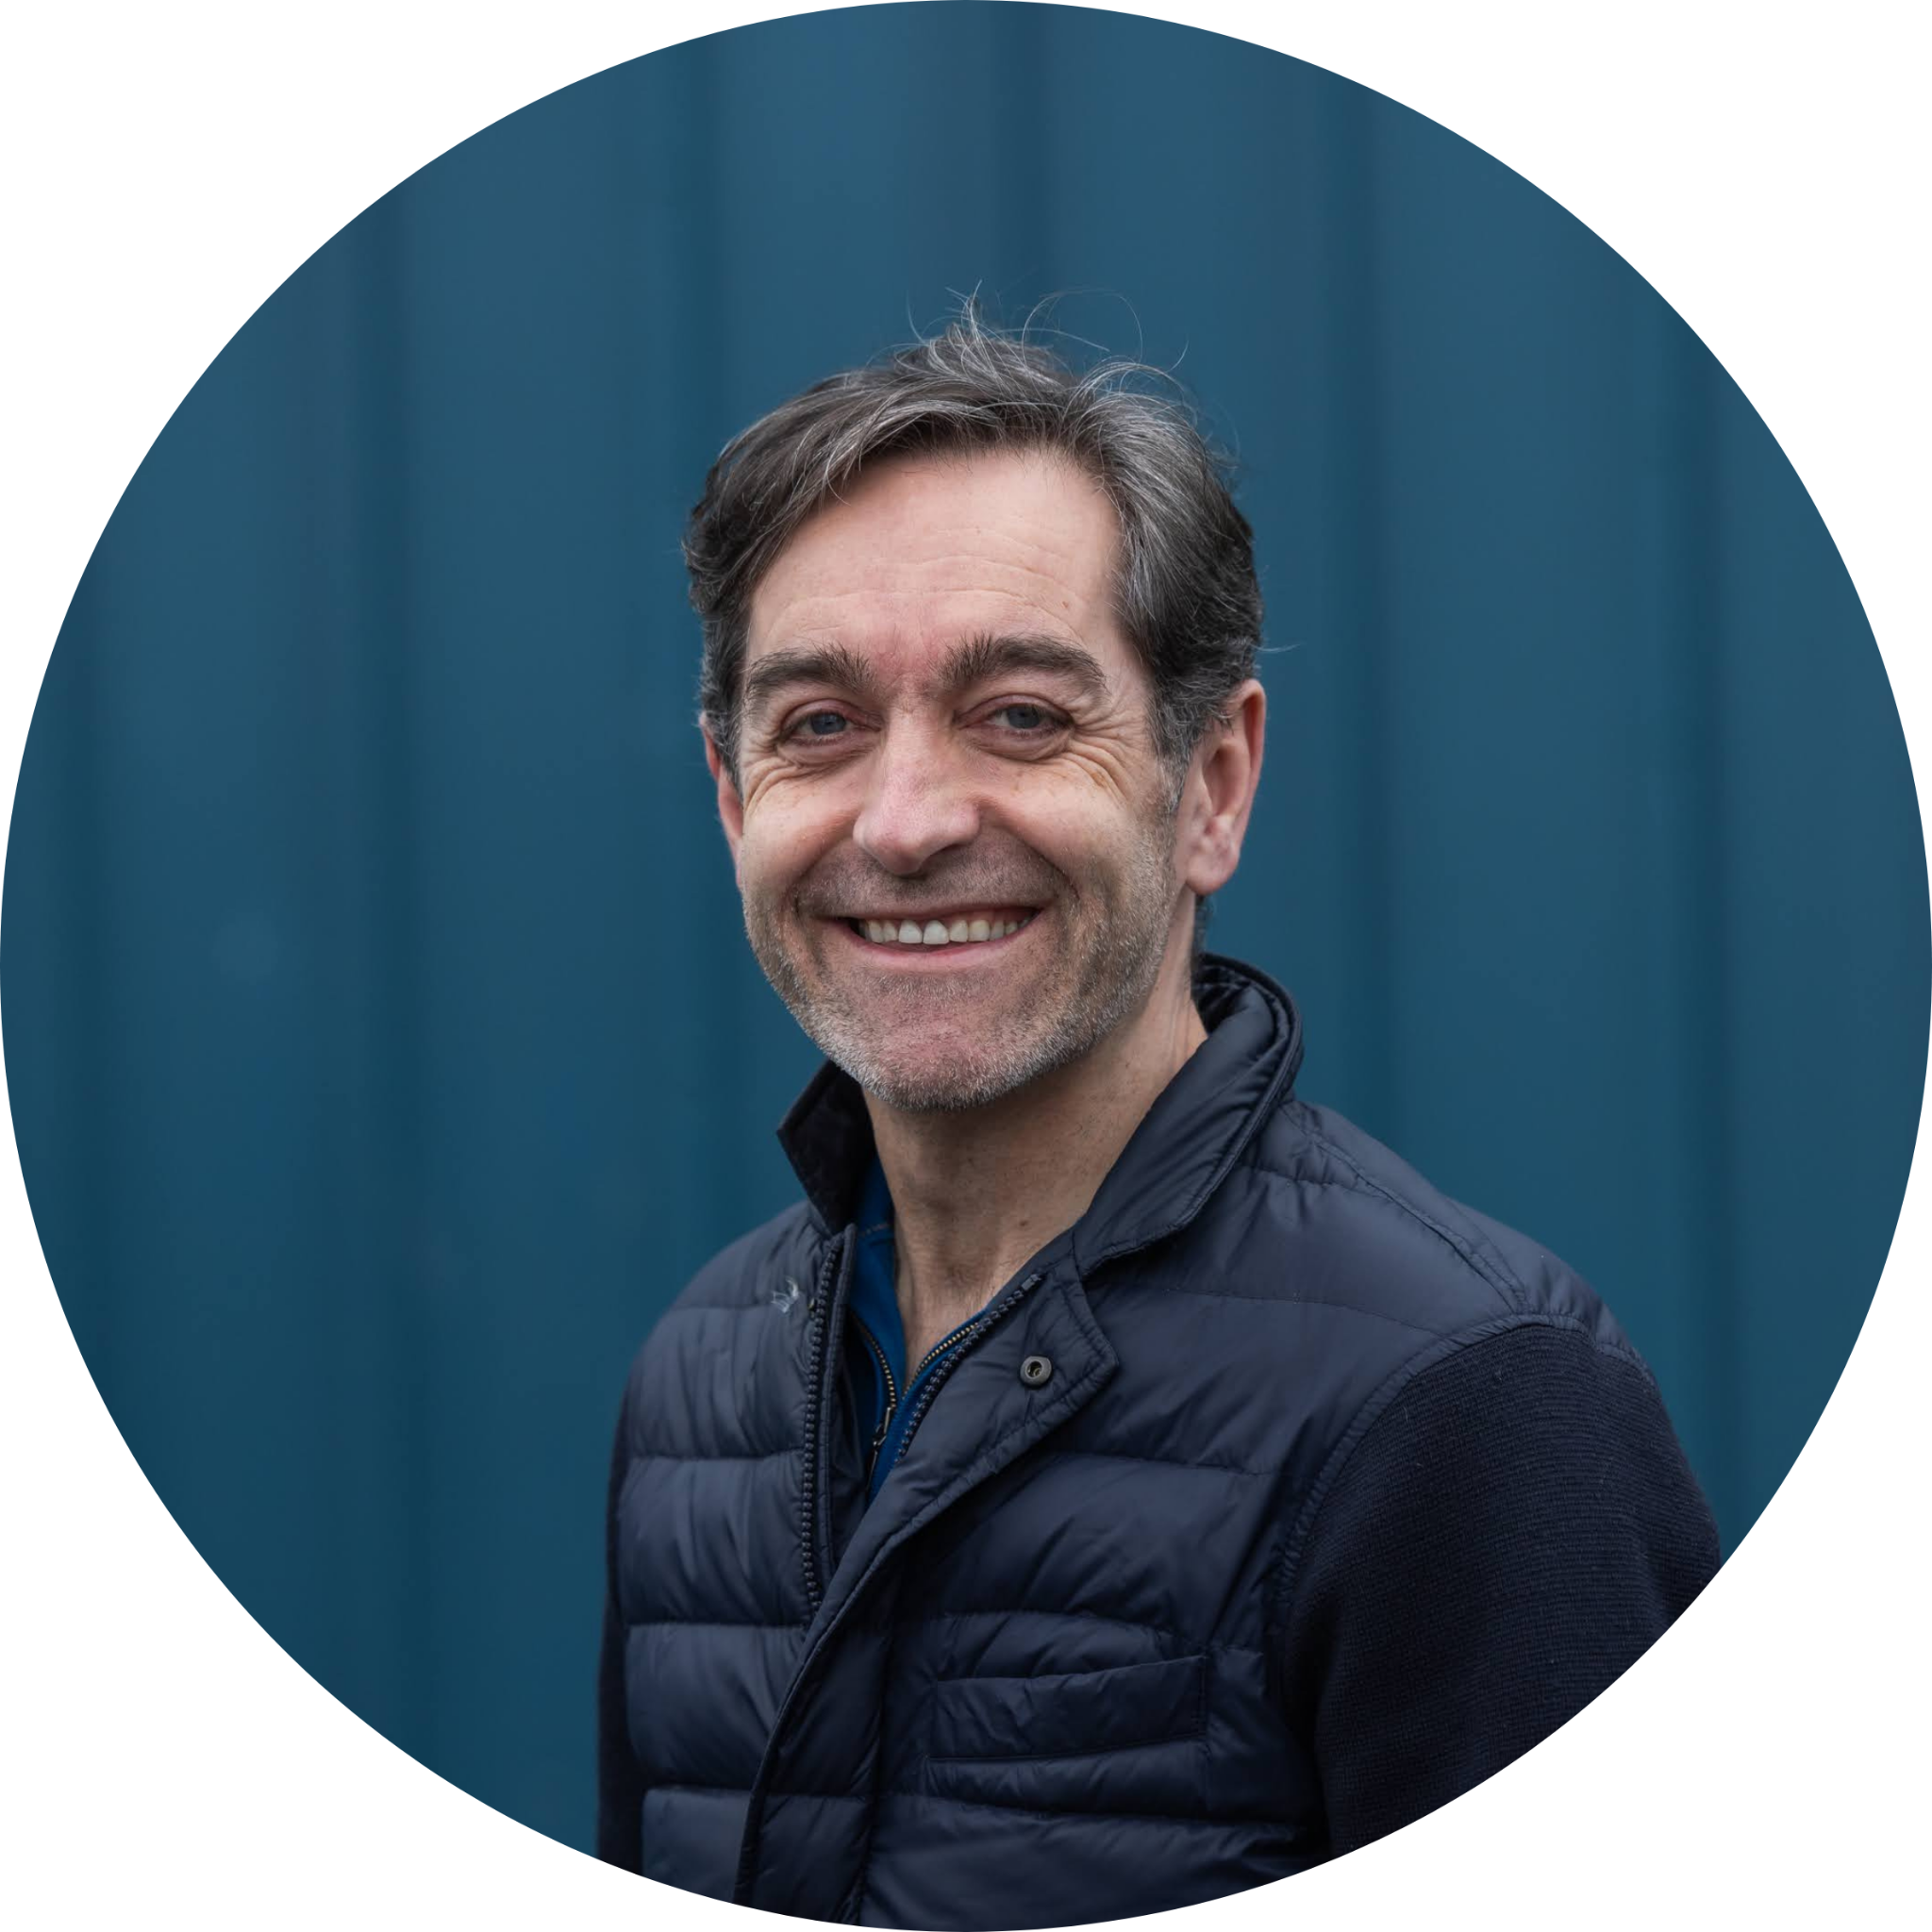

Keynote Address
James Dunbar
Chief Executive, New Start Highland

Slide 24


The Journey of New Start Highland and our Training and Reuse Village

Slide 25


Slide 26
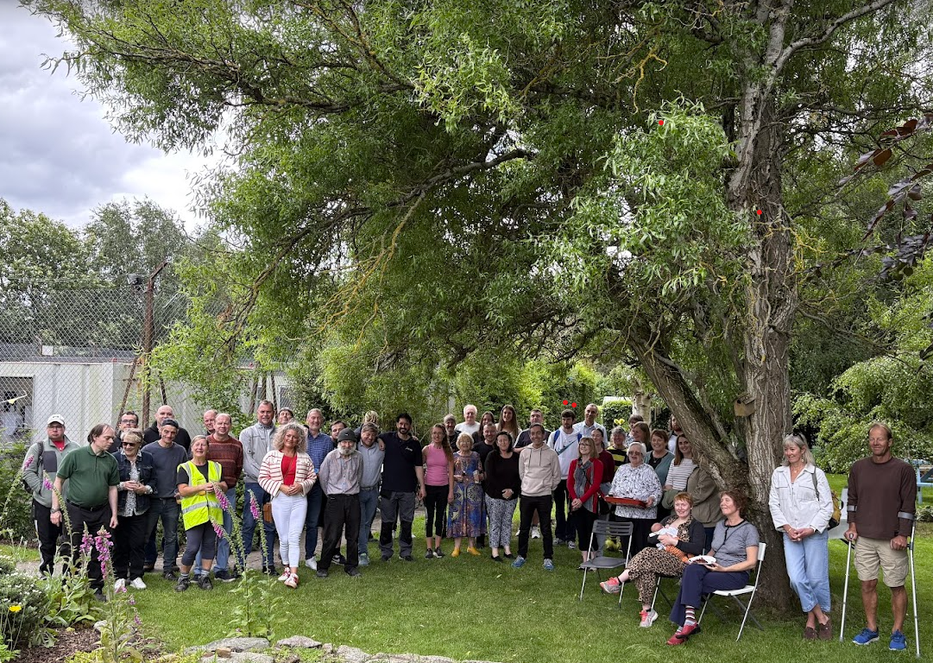
25 years creating positive change
Team of over 100
£3m turnover, 85% self generated
30,000 furniture packs distributed
12,000 tonnes of furniture diverted
Over 1,000,000 items reused
100% solar powered
Training and Reuse Village.

Slide 27




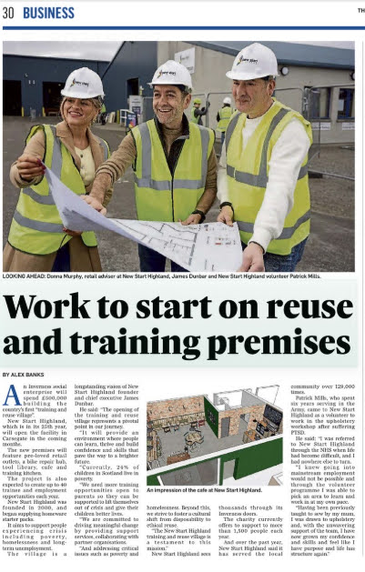

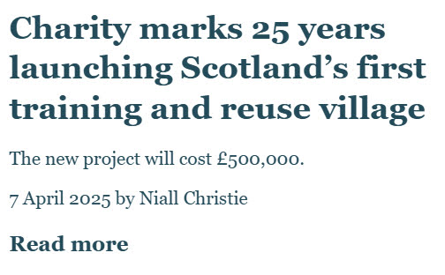

A first for Scotland
Behavioural change
Cost of living crisis
Striving for a Net Zero future
Education and training opportunities
Young people services.

Slide 28

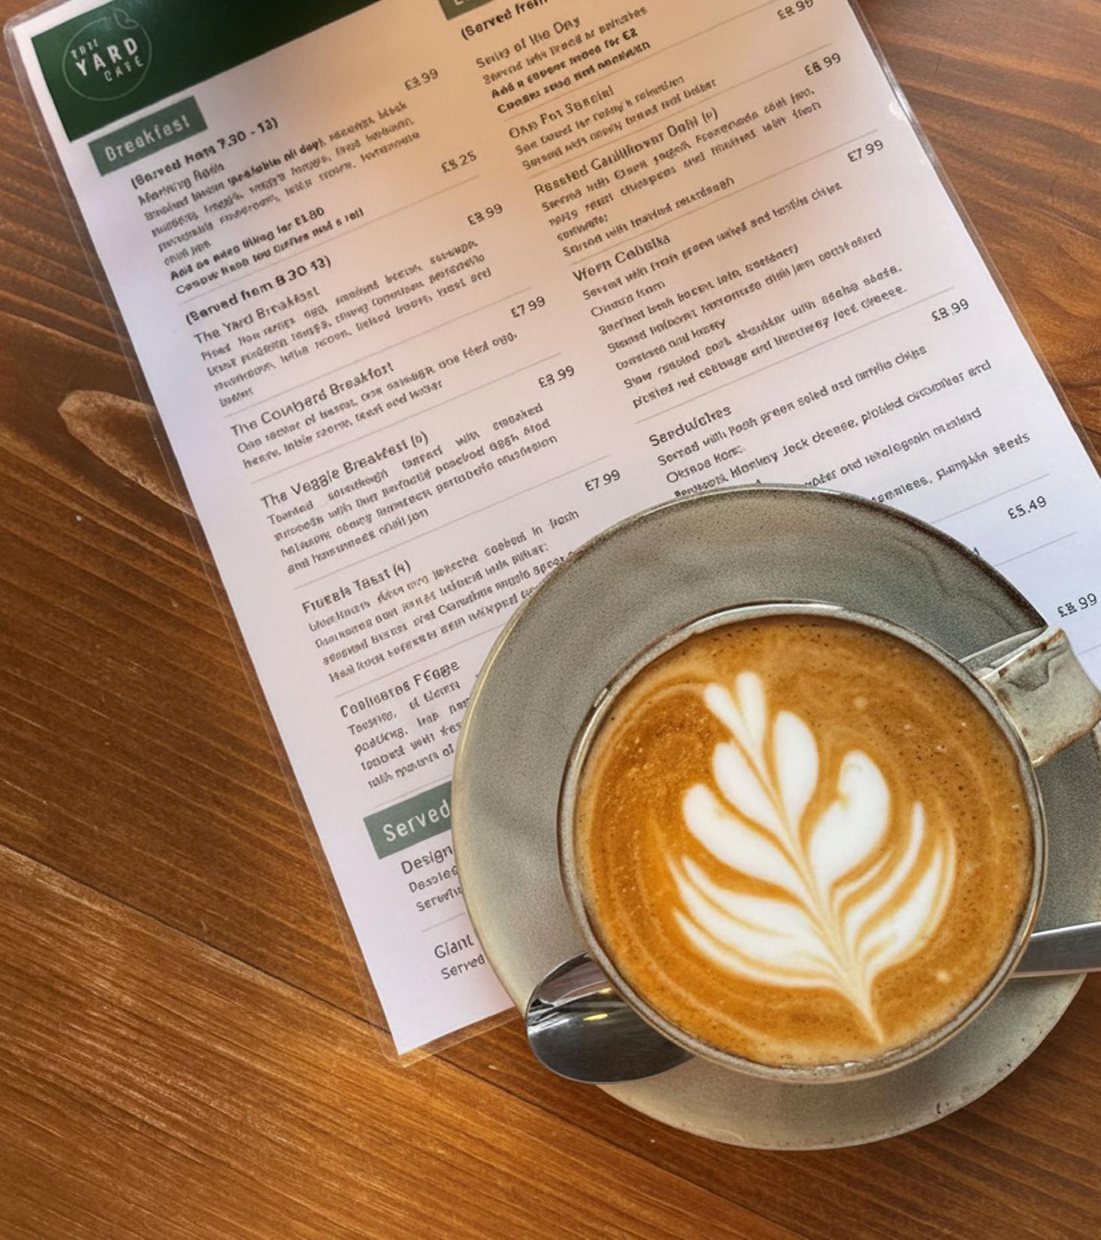
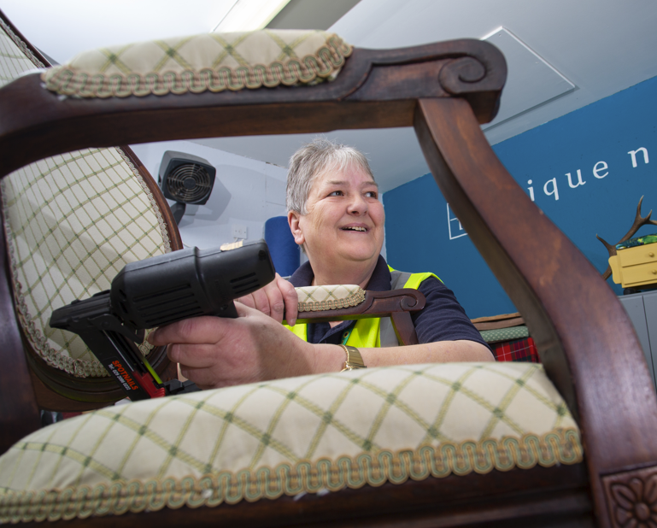

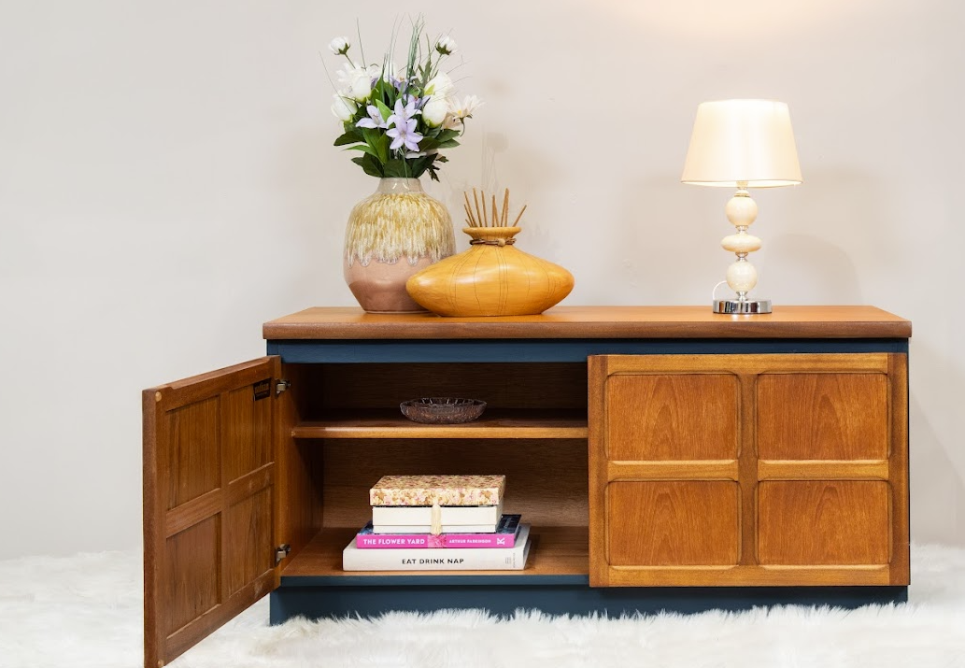
A dual focus
Reuse and concessions
Learning
Unique Ness
One of a kind pieces
Helen’s story
Highland Hospitality School at The Yard
Barista coffee and homemade cakes
People into employment.

Slide 29














Working together

Slide 30
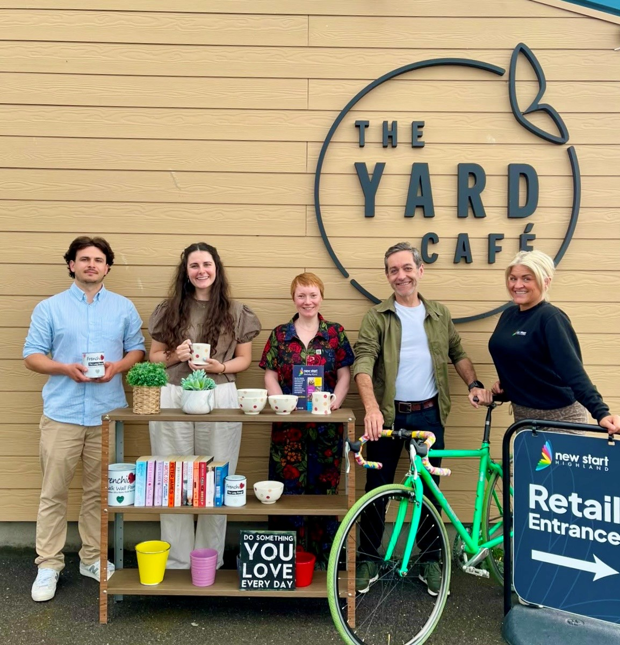
Social enterprise and the best of business
Vision
Team
Delivery
Recognition
Influence.

Slide 31


e: james@newstarthighland.org

Slide 32
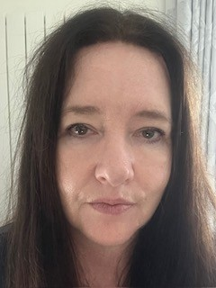
Keynote Address
Fiona Ferguson
DAERA

Slide 33


Slide 34

A new way of working
A Food Systems Approach
Cross-departmental working to achieve outcomes
Reflects different strategic drivers anticipated over the coming decades

Slide 35
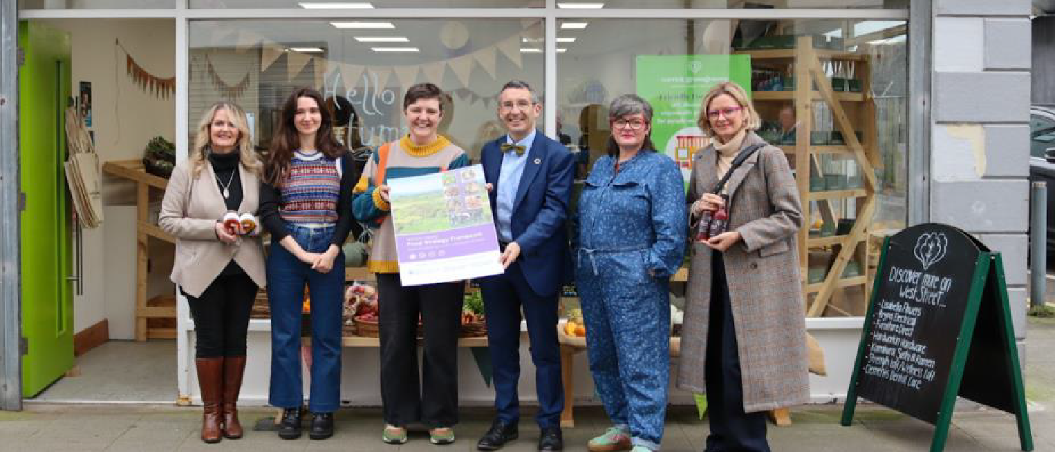
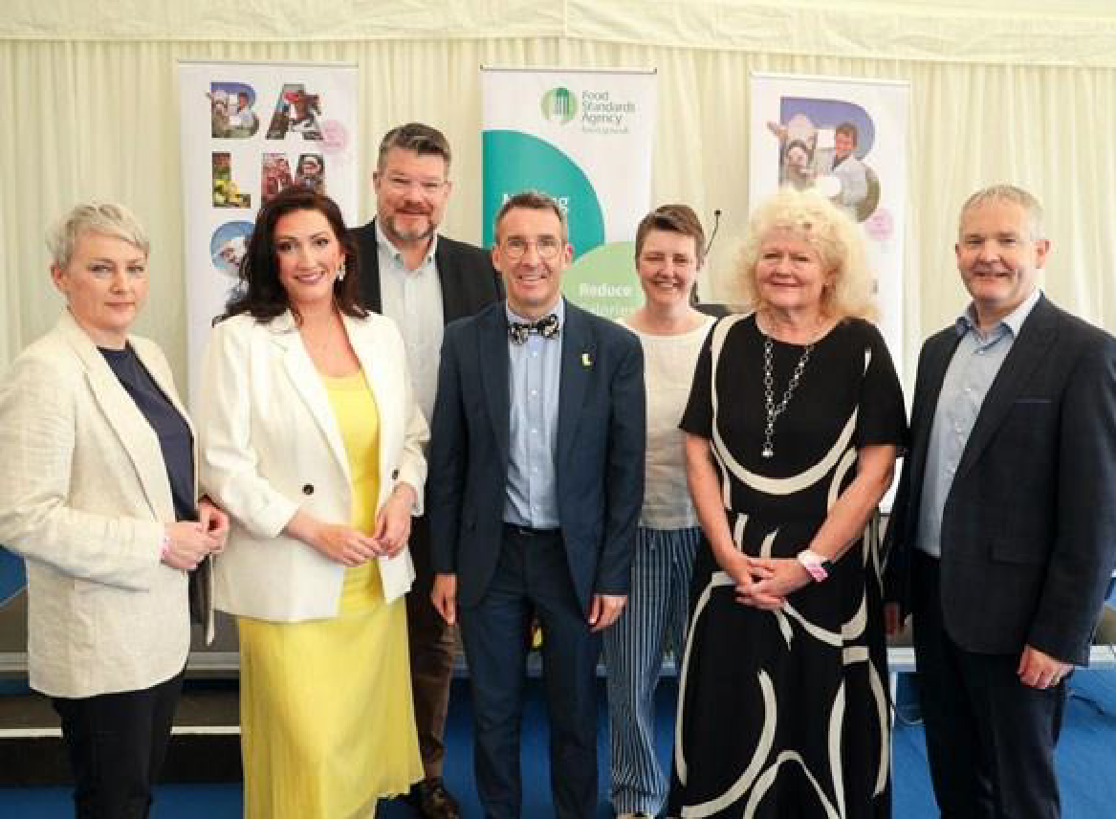
NI Food Strategy Framework - timeline
Executive Approval – 18 July 2024 / Published in November 2024
Executive Approval of 2 -year Food Action Plan / Launched at Balmoral Show – May 2025
Included in Programme for Government – Shaping a Better Tomorrow Section

Slide 36
The Framework Vision
“A transformed innovative food system that protects and enhances natural resources for future generations, is environmentally sustainable, economically ambitious, and provides safe, nutritionally balanced, accessible food for all.”

Slide 37
Scope
“A holistic approach ‘from Source to Society’, encompassing the production, processing, distribution, supply, marketing, consumption of food* and handling of waste and the consumer values and behaviours that influence these processes.”
* The term food includes food, drink, fish and marine.

Slide 38
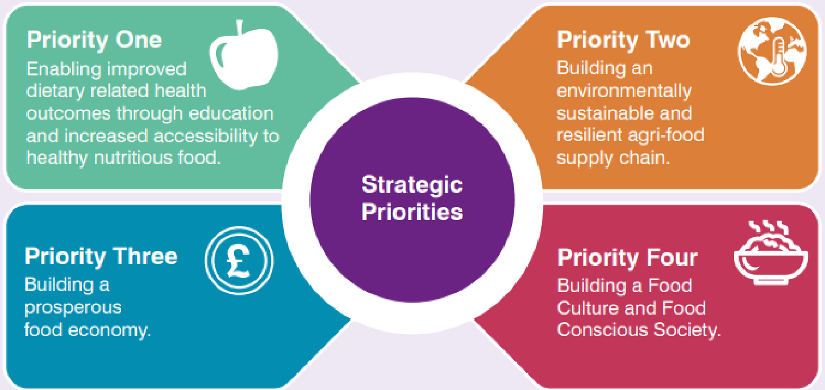
Framework Strategic Priorities

Slide 39
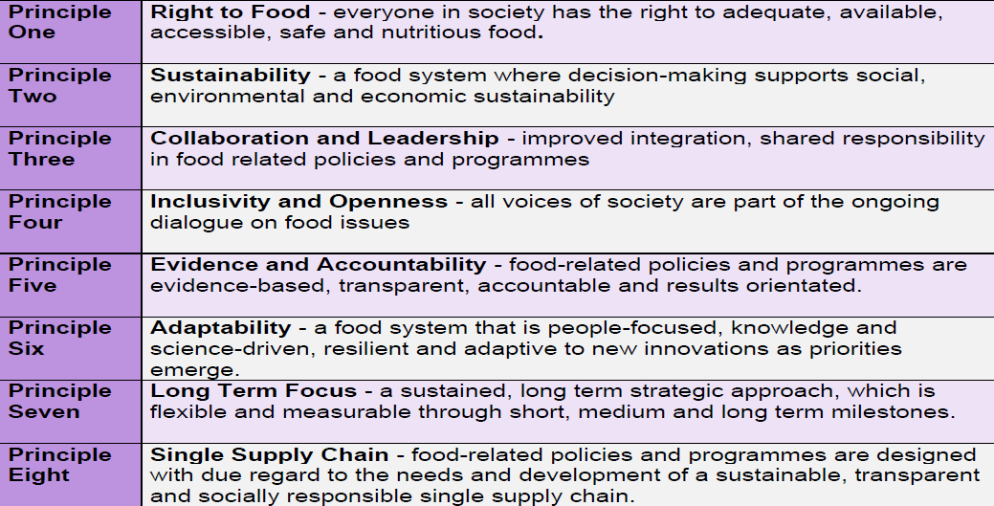
Guiding Principles

Slide 40
Food Action Plan – Approach Taken
Delivery within two years – 2025-2027
Recognises budgetary pressures / policy development
Low or No cost actions
Thirty-nine actions
Each Action has a lead department
Building foundations, working together
Report to Executive after 2 years

Slide 41
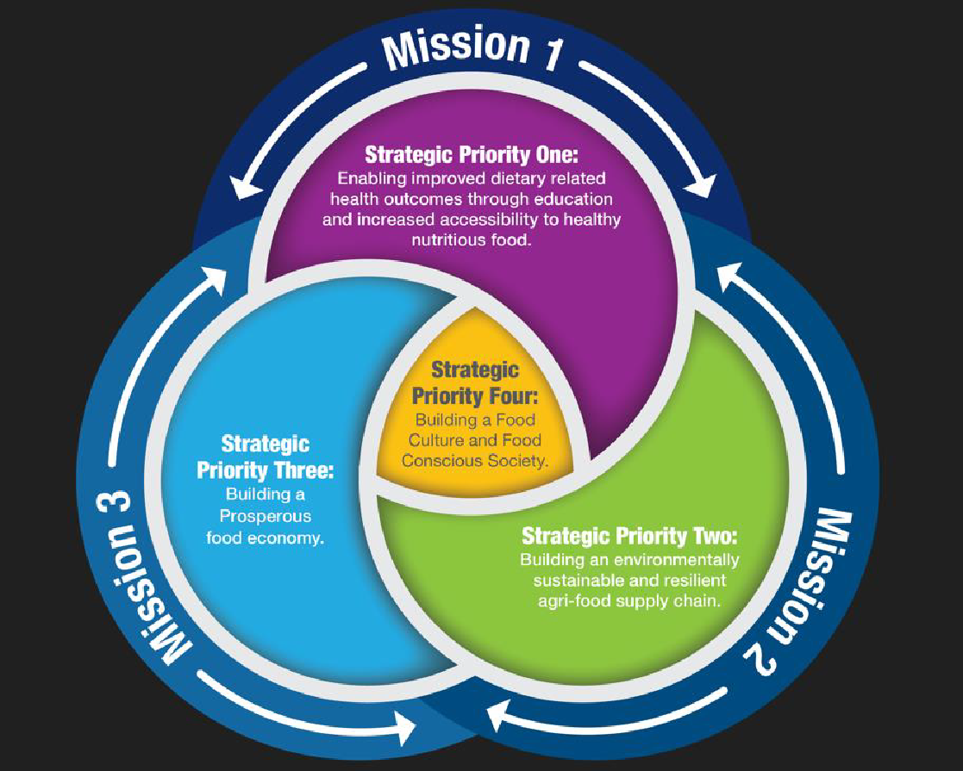
Approach: Three Missions
Mission One - To use food to improve lifelong health and wellbeing Mission Two - To support environmentally sustainable, safe and ethical agri-food supply chains Mission Three - To further develop sustainable economic prosperity within the agri-food sector

Slide 42
Food to Improve Lifelong Health and Wellbeing
Theme – Addressing Food Inequalities
1.1 Develop a cross departmental approach to applying the “Right to Food” guiding principle as set out in the NI Food Strategy Framework.
1.2 Co-design a Community Food Challenge Scheme with key stakeholders (subject to budget availability) aimed at supporting community initiatives that help deliver the overarching goals of the NI Food Strategy Framework.

Slide 43
Food to Improve Lifelong Health and Wellbeing
Theme – Addressing Food Inequalities cont.
1.3 Work with key stakeholders to build a culture of redirecting surplus food to those who will benefit from it and help alleviate food poverty.
1.4 Explore opportunities to utilise existing community-based interventions such as Social Supermarkets and/or programmes in disadvantaged communities to promote healthy eating messaging, and awareness of how to store, prepare, cook food and minimise waste.

Slide 44
Food to Improve Lifelong Health and Wellbeing
Theme – Food Interventions targeted at Children and Young People
4.1 Engage with Children and Young People from diverse backgrounds, using existing forums where possible to inform policy making and co-design future food interventions.
Theme - Accessibility to healthier food
5.3 Support food businesses to make the food environment healthier through reducing calories, saturated fat, sugar, and salt in the food they produce, sell or serve, reducing portion size and providing nutritional information.

Slide 45
To Support Environmentally Sustainable, Safe and Ethical Agri-Food Supply Chains
Theme - Increase awareness and understanding of circular practices within agri-food businesses.
4.1 Work across government to promote pathways that support a circular approach and increase business awareness of opportunities for circularity.
4.2 Reduce edible surplus food going to waste:
  to reduce impacts of food waste on the environment and climate; and
  divert food surplus (pre and post farm gate edible food) to benefit the community and help alleviate food poverty.

Slide 46
To Support Environmentally Sustainable, Safe and Ethical Agri-Food Supply Chains
Theme -Food Security - Resilience.
8.2 Collaborate with key stakeholders to investigate the barriers and opportunities to expanding community growing spaces and build community food resilience.

Slide 47
To Further Develop Sustainable Economic Prosperity Within the Agri-Food Sector
Theme – Promotion of Northern Ireland Food
9.1 Review the existing DAERA led Northern Ireland Regional Food Programme to ensure alignment with the ambition of the NI Food Strategy Framework.
9.2 Continue to work alongside Tourism NI and other key stakeholders to align messaging and develop plans to promote Northern Ireland’s food and drink offering.

Slide 48
Looking Forward – Encouraging everyone to play their part
Continue raising awareness / Socialising The Framework to build awareness and understanding of why food matters
Recognise the importance of communities, councils and valuing the work already happening at local level.
New Action plan under development potential 3-5 year timeline
Using systems approach, want to work collaboratively with stakeholders to drive actions on the ground
Strong links with DoH Healthy Futures Strategy, Climate and Environment related strategies, building food resilience and strengthening local economies and building our food culture.
A focus on young people, place and communities.

Slide 49
Thank you

Slide 50
Comfort Break
12pm - 12.15pm

Slide 51
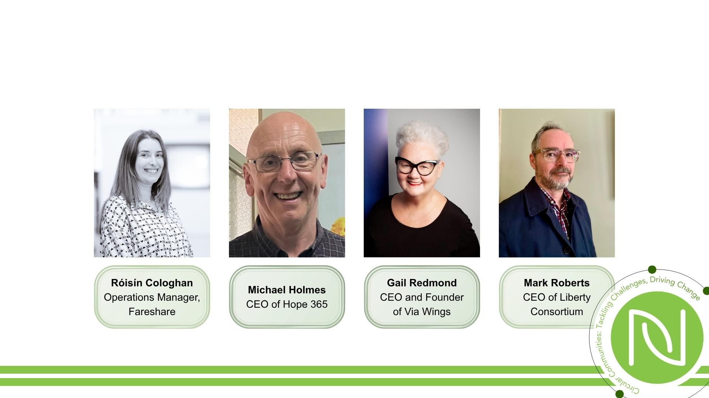
Member Panel Discussion

Slide 52
Lunch
NIRN AGM
1pm - 2pm
1.40pm - 2pm
O’Hampsey Suite

Slide 53


The Art of Change: Building Circular Schools Through Artitude and the Climate Wheel
Julie Armstrong and Orlaith Quinn

Slide 54
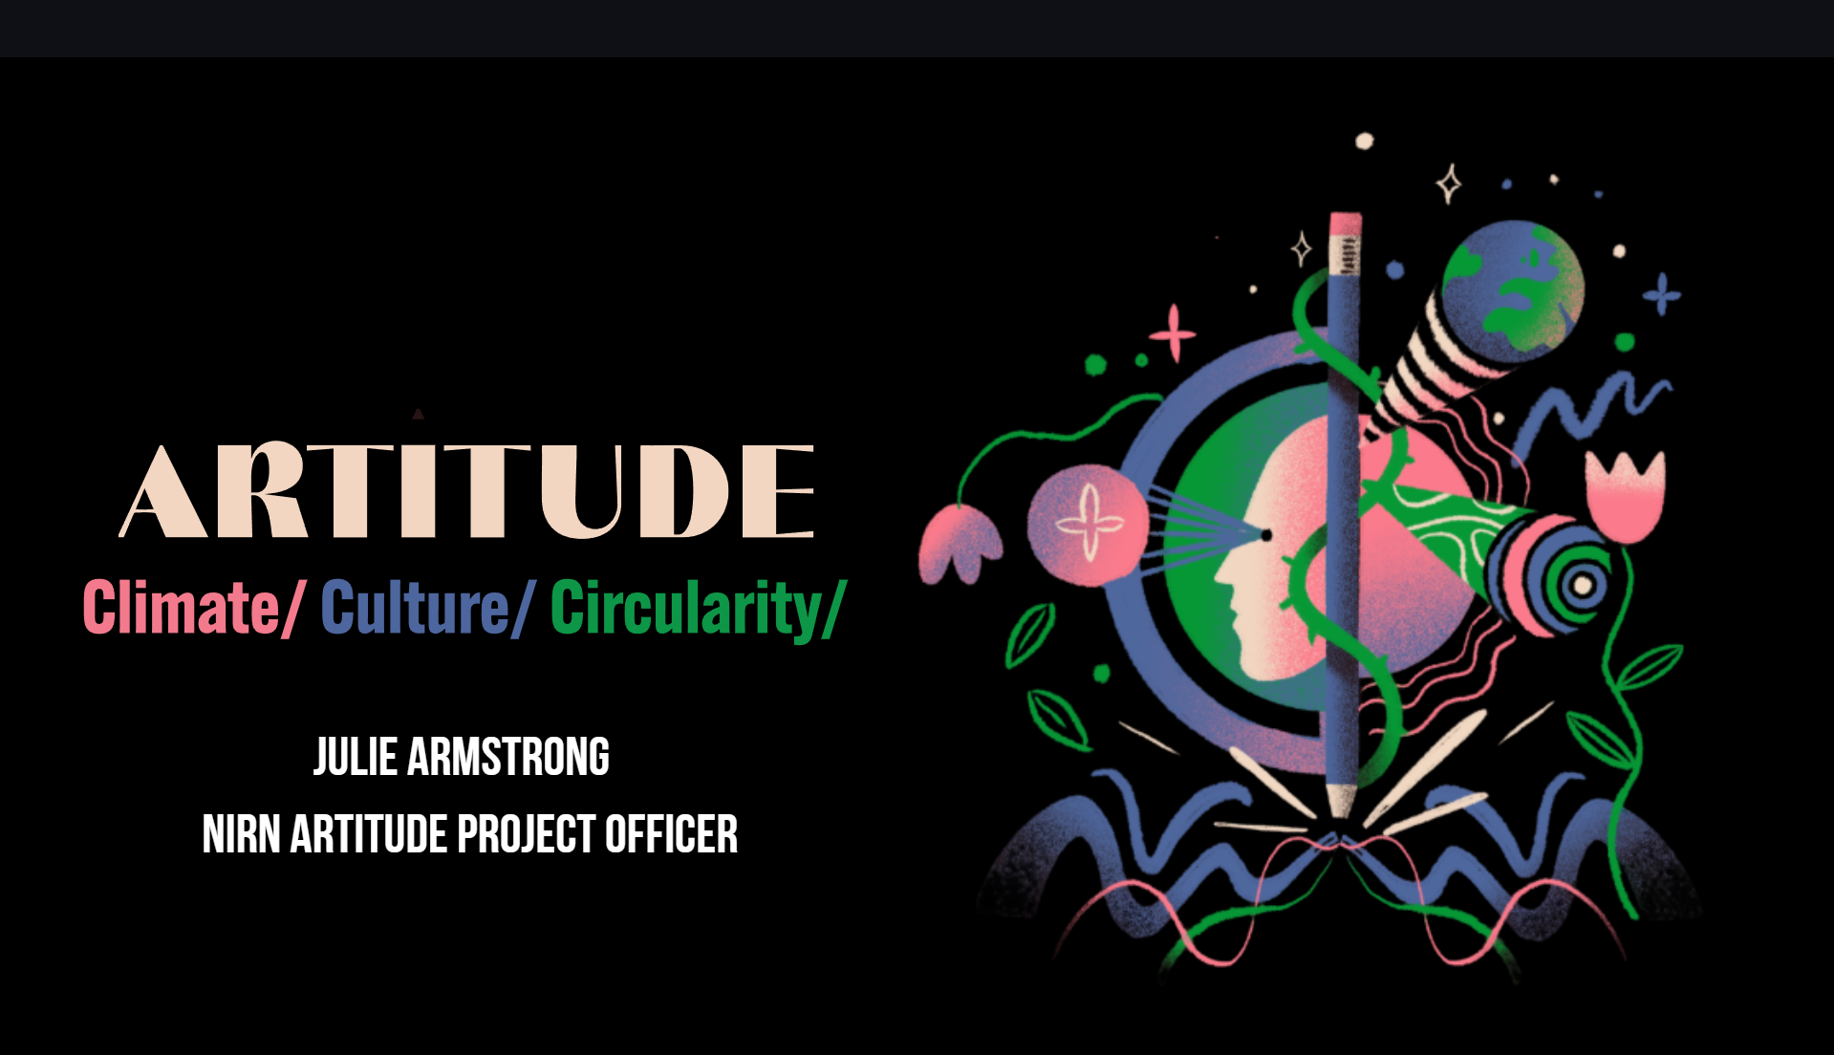

Slide 55
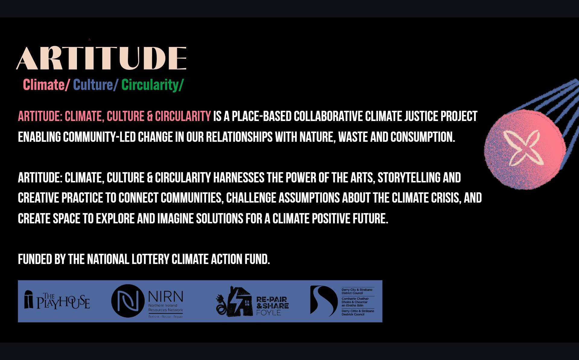

Slide 56
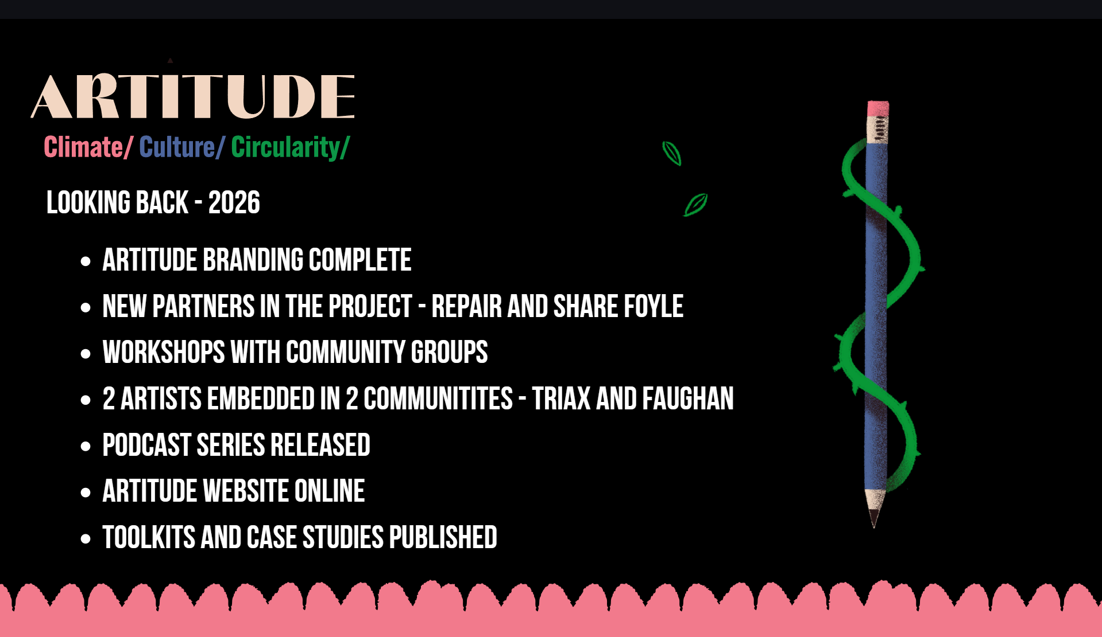

Slide 57
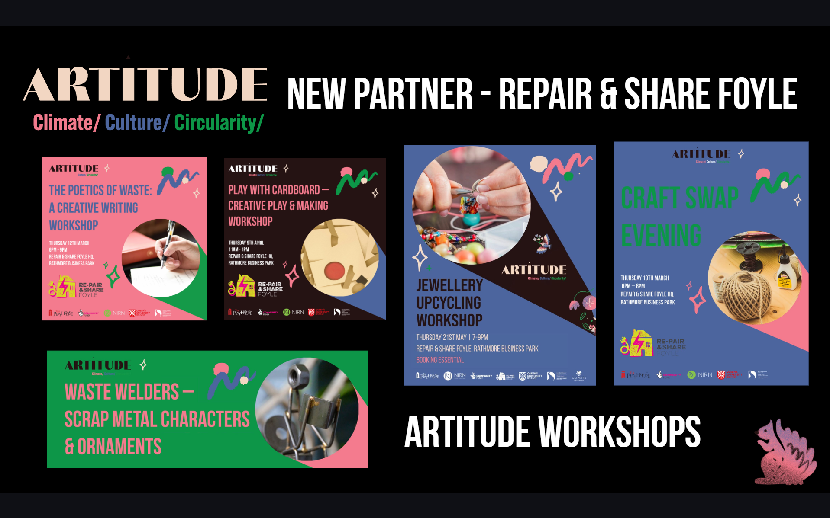

Slide 58


Slide 59


Slide 60


Slide 61


Slide 62


Slide 63


Slide 64
The Circular Schools Programme
Órlaith Quinn - Environmental Education Officer

Slide 65





About the Circular Schools Programme
Circular Schools is a pilot education programme introducing young people to the circular economy and waste prevention through practical, activity-led workshops.
Pupils explore how we can prevent waste, use fewer resources, and reuse and repair what we already have, across themes including food, textiles and electrical waste.
As a pilot, each year of delivery provides learning and feedback that helps us evolve and improve the programme further.
Notes:
To give a little bit of background on Circular Schools, it is a pilot education programme that introduces young people to the circular economy and, importantly, waste prevention.
The workshops are very practical and activity-led, so pupils aren’t just sitting listening to information. They get the opportunity to explore different waste streams, including food, textiles and electrical waste, and think about how we can keep those resources in use for as long as possible.
A big focus of the programme is moving beyond recycling. We want pupils to understand the waste hierarchy and think about what we can do before something becomes waste, whether that is preventing waste in the first place, using less, or reusing and repairing the things we already have.

Slide 66






Circular Schools: What We Explore
Circular Economy
Understanding circularity and keeping resources in use for longer.
Electrical Waste
Exploring e-waste and the importance of reuse and repair.
Textile Waste
Exploring textile waste, reuse and repair.
Food Waste
Understanding food waste and how we can prevent and reduce it
Notes:
In Year 2 of the programme, we worked with 18 schools across six council areas, reaching around 690 pupils.
The workshops were centred around four main themes. We start with an introduction to the circular economy and then explore three key waste streams, electrical waste, textiles and food.
This gives pupils the opportunity to look at different types of waste and think about how we can prevent and reduce it, as well as reuse and repair items to keep resources in use for longer.

Slide 67





From Toolkit to Classroom
The Climate Wheel Toolkit uses creative and interactive learning to explore circularity, waste prevention and resource use.
The approach has been adapted for Circular Schools, creating a Waste Prevention Wheel linked to the themes and waste streams pupils explore throughout the programme.
Notes:
The Climate Wheel Toolkit provides a creative and interactive way of exploring ideas around circularity, waste prevention and how we use resources.
These themes link closely with what we are already exploring through Circular Schools, particularly around the different waste streams.
The toolkit provided the inspiration to adapt this approach for a school setting, creating our own Waste Prevention Wheel. The aim was to create something pupils could physically interact with, while connecting directly to the learning and themes within the programme.

Slide 68






The Waste Prevention Wheel
12 facts, questions and discussion prompts
linked to food, textiles and electrical waste
Inspired by pupil research during the Circular Economy Introduction Workshop
An interactive resource for discussion, learning and reflection
Notes:
The Waste Prevention Wheel contains 12 facts, questions and discussion prompts linked to the key themes pupils explore through Circular Schools, food, textiles and electrical waste.
The content comes from the Circular Economy Introduction Workshop, where pupils carry out desktop research into different waste streams and explore how they connect to waste prevention and the circular economy.
This research helps shape the content of the wheel, so it becomes a way of bringing that learning back into the classroom and creating further opportunities for discussion and reflection.

Slide 69



More Than Just a Resource
Visual tools can make complex ideas easier to understand and provide a starting point for discussion.
The Waste Prevention Wheel uses simple facts, questions and visual prompts, while its reclaimed materials reinforce the message of reuse and resourcefulness.
Encouraging pupils to question, discuss and rethink waste.
Notes:
Visual tools can be an effective way of making some of the more complex ideas around circularity easier to understand, particularly with younger pupils.
The wheel breaks these ideas down into simple facts and questions, giving pupils something visual and interactive to respond to, rather than just presenting them with information.
The fact that the wheel itself is made from reclaimed materials also reinforces the message we are trying to get across, demonstrating reuse and resourcefulness in practice.
Ultimately, it is about encouraging pupils to question what happens to the things they use, discuss different possibilities and start thinking differently about waste and resources.

Slide 70
thank you
for listening!

Slide 71

Breakout Rooms
RED BREAKOUT ROOM
Achieving Financial Sustainability Whilst Delivering Social and Environmental Impact (James Dunbar)
YELLOW BREAKOUT ROOM
From Cans to Cottages, Waste to Welcome: A Real Social Enterprise Journey (Compass Advocacy Network)
BLUE BREAKOUT ROOM
Food at the Heart of Communities - Growing a Positive Food System (DAERA)
PURPLE BREAKOUT ROOM
Textiles Hackathon: Rip It Up and Start Again (ReJig)

Slide 72


Thanks and Close

